Slide 1
1956 DeWitt DeHawks Football Team
Central Dewitt Hall of Fame
Induction Class 2007

Slide 2
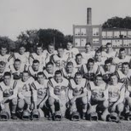
Inducted for Outstanding Contributions as a team/ group of Central High School

Slide 3
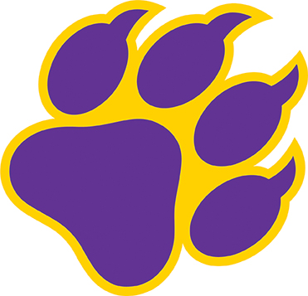
Biography
The 1956 DeWitt DeHawk Football team is the ONLY football team in school history to complete a perfect, undefeated and untied season. That season, the DeHawks defeated Maquoketa, Fulton, Savanna, Amboy, Morrison, Bettendorf, Sterling Newman, and St. Mary’s.

Slide 4
Article from the Observer
The 1956-57 school year was an exciting time for the DeWitt High School athletic teams and its fans.
In the fall of 1956, the DeHawks accomplished something no other DeWitt football team had done previously by posting a perfect record. On its way to an 8-0 record, the DeHawks outscored their opposition by a com- HALL OF FAME/continued on page 20 Don McCune Joel Moeller Joe Ryan Ellen Wagener bined score of 214-25.
The DeHawks were equally dominant on both sides of the ball. The offense averaged 370 yards per game on its way to scoring 30 touchdowns in the eight games. Most of the offense came via the ground game, which accounted for 2,419 of the offensive total of 2,963 yards. Chuck Runge was the team’s leading rusher, running for 1.157 yards. With 14 touchdowns, Runge ended his career with 32 touchdowns, a program record at the time.
Defensively, the team allowed a mere four touchdowns, and never more than one in a game. The DeHawks shut out four opponents, including a 19-0 whitewashing of Morrison, in its only loss of the Illowa season. Opposing offenses managed an average of just 77 yards per game.

Slide 5
The Observer (cont.)
The defense also scored three touchdowns, one coming on an interception. Starting with Savanna (14-0), followed by Amboy (26-0) and concluding with Morrison, the defense recorded three consecutive shut-outs.
The DeHawks opened the season with a 12-7 non-conference win over Maquoketa. It was the only time during the season the DeHawks did not prevail by more than a touchdown. The game was also the only time the team trailed (7-6) the entire season.
In addition, only Savanna and Bettendorf (20-6) stayed within two touchdowns of the DeHawks. Following the team’s 34-6 win over Clinton St. Mary’s in the season finale, clinching the Illowa Conference championship in the process, head coach Harold Birney told The DeWitt Observer,
“There’s no question but what this was the greatest team I’ve ever coached. The reason for this is balance. Never before have I had at one time so many good blockers and tacklers.” Birney also credited a smart group of players. Supporting that statement was the fact the top four students, and six ofthe top 12, in the 1957 graduating class were members of the football team.

Slide 6
The Observer (cont.)
In addition to Runge, team members included Jan Bergert, Mel Boyer, Ray Clement, Jay Dockendorf, Harry Doughty, Ron Elmergreen, Harlan Fischer, Bob Fletcher, Ray Holst, Jon Hulting, Dan Kaufmann, John Kleinsmith, Larry Koepp, Bob Lee, Jack Martin, Dennis Mumm, Gene Nickles, Ron Neessen, Eugene Otto, Andy Perry, Richard Schanze, John Schnack, Bob Seifert, Neal Sodemann, John Sorenson, Gary Stoefen, Bob Storey, Nick Storjahan, Alan Talkington, Morgan Tobin and David DeWulf. Joining Birney on the coaching staff were Ray Oles, Howard Ehrler, Hank Vining and Dusty Rhodes. Clement, Neessen, Runge and Stoefen earned first-team All-Illowa honors. Boyer and Dockendorf were second-team selections, with Fischer, Holst, Nickles, Schnack, Seifert and Talkington earning honorable-mention accolades.

