Slide 1
1990 Central Sabers Girls Track Team
Central Dewitt Hall of Fame
Induction Class 2006

Slide 2
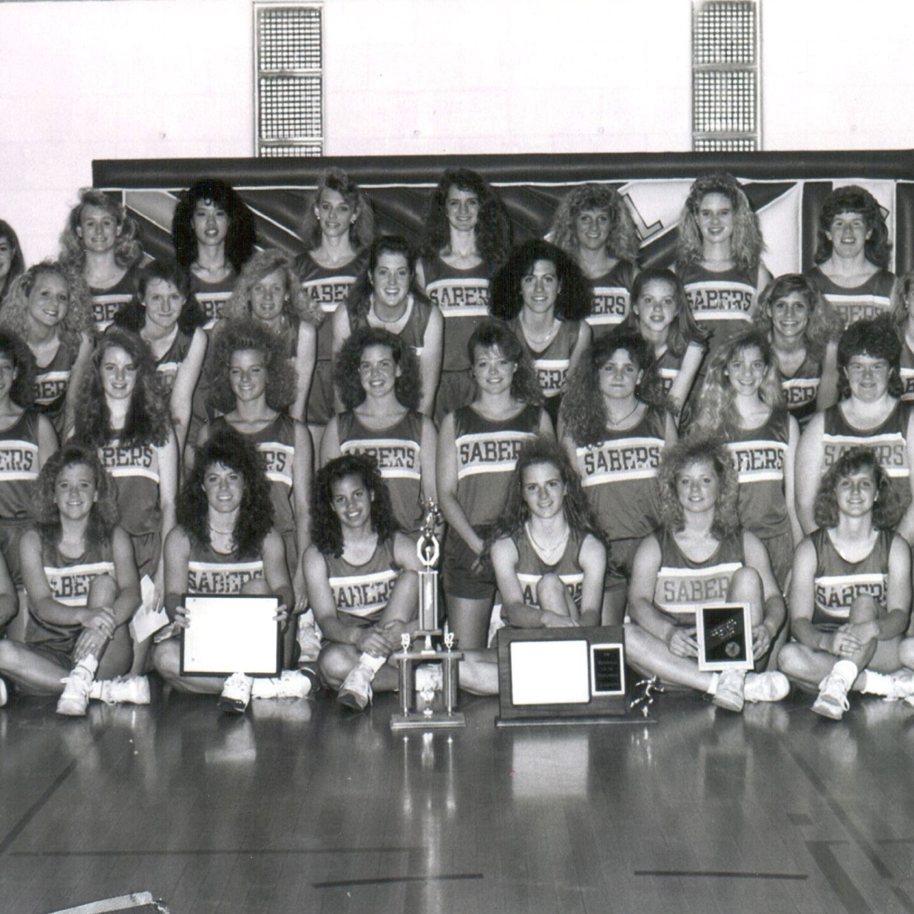
Inducted for Outstanding Contributions as a Team/Group of Central High School

Slide 3
Biography
The 1990 Girls Track is the first GIRLS team to earn a state championship for Central High School. Pam Duncan, a Hall of Fame inductee from 2003, Deb Hansen, and Darla Hamrick coached the team. The Sabers track team had several champions at the IGHSAU State meet that year:
Brandy Scheckel—400 m Hurdles
Distance Medley—Angie Rowson, Nikki Claussen, Joanna Schroeder, Heidi Pote
Sprint Medley—Angie Rowson, Nikki Claussen, Joanna Schroeder, Laurie Pote
4x400m Relay—Nikki Claussen, Joanna Schroeder, Laurie Pote, Chari Corsolini
The team title came down to the final race at State, the 4x400m Relay. Central needed to finish ahead of Tipton. If the Sabers finished 2nd and the Tigers finished 4th, the Tigers would have won the title. Instead, the Sabers took the 4x400m title while the Tigers finished 5th.

Slide 4
Article from the Observer
The 1990 Saber girls track team made history winning the 1990 class 2A state championship – they were the first Central girls athletic team winning a state championship. Under the direction of Central Hall of Fame coach Duncan, the Sabers went into the state meet knowing they had a shot at the state title.
“We knew very much going into the meet, we had a chance to win,” Duncan told The Observer in a 1999 interview. “Right before the district meet we were at the Tipton Relays. Tipton was the two-time defending state champs and we beat them by one-third of a point. Sigourney was third. They ended up winning the class 1A meet, we won class 2A and Tipton finished second, behind us.” Or maybe it was because of something another member of the Central Hall of Fame – Brandi (Scheckel) Simmons – read in her horoscope the day the Sabers clinched the championship. It read “This is a lucky day.” Actually, talent and coaching had a lot more to do with winning state than luck.
On their way to winning the state title, the Sabers won four individual events – Scheckel in the 400-meter low hurdles; the distance-medley team of Angie Rowson, Nikki Claussen, Joanna Schroeder and Heidi Pote; the sprint-medley team of Rowson, Claussen, Schroeder and Laurie

Slide 5
The Observer (cont.)
Pote; and the 4X400 quartet of Claussen, Schroeder, Laurie Pote and Chari Corsolini. The meet wasn’t won until the last race — the 4X400-meter relay. Going into the race, two-time defending state champion Tipton held a 46-41 lead over the Sabers. With a 4:07.02, the Sabers had the fastest qualifying time, while Tipton ranked fifth. If those spots held up, the Sabers win state. If they drop one spot and the Tigers were to move up one, Tipton would have made it three state championships in a row. That never happened, the Sabers chopped a whopping six seconds off their qualifying time, while Tipton’s 4:09.5 placed them right where they qualified – fifth.
“We were quite confident we would win the race,” Duncan said. “The question was how high would Tipton finish. We needed one other team to finish ahead of them. None of our fans were watching us, they were all watching Tipton. It was close, I believe, but somebody beat them, so we were the champions.”

Slide 6
The Observer (cont.)
Team members included Denise Schuster, Amy Simon, Melissa Mayberry, Schroeder, Rowson, Carrie Landau, Chris Thiltgen, Jennifer Schwendinger, Dawn Jacobs, Amy Sheil, Chris Richards, Dee Bowman, Melinda McGarry, Becky Balvin, Lisa Hlubek, Angie Spangler, Angi Kopp, Jill Hanrahan, Jessica Rogers, Jennifer McDonald, Nadene Harbeck, Corsolini, Julie Kleinsmith, Heidi and Laurie Pote, Shelly Balvin, Amy Schrader, Stacy Palzkill, Anne Burken, Lisa Peters, Bo Pierce, Claussen, Scheckel, Diane Schultz and Brenda Bowman. Duncan’s assistant coaches were Deb Hansen and Darla Hamrick.

