Slide 1
2009 boys track state champion team
Central Dewitt Hall of Fame
Induction Class 2020

Slide 2
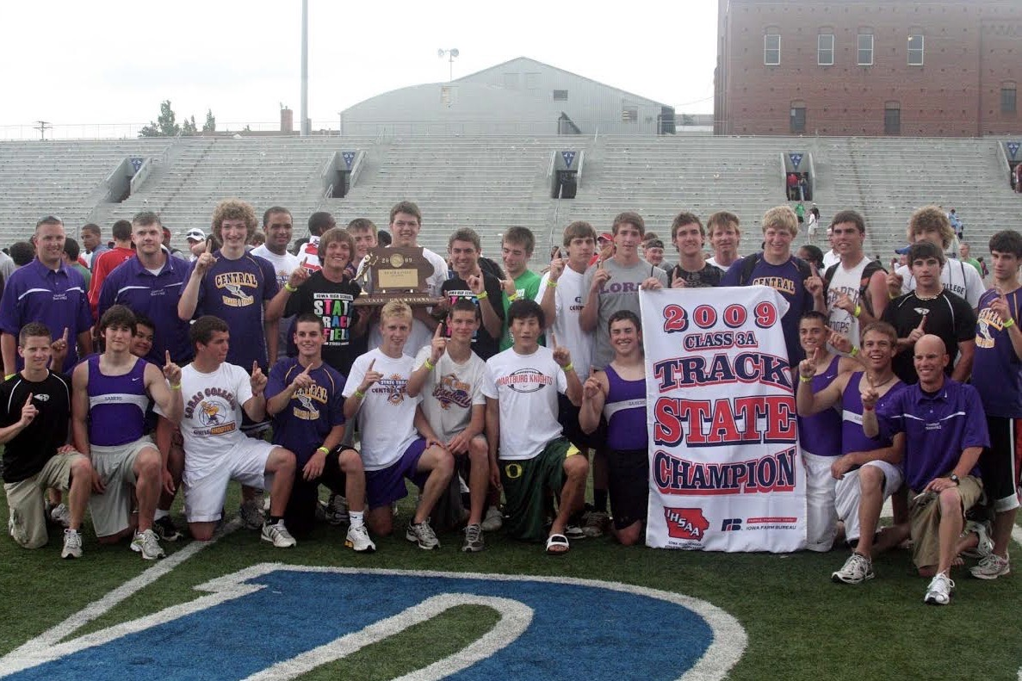
Inducted for Outstanding Contributions as a Team of Central dewitt High School

Slide 3
Biography
The Central DeWitt Boys Track team won a conference title, district title, and state title in 2009. The 2009 team propelled the success that would follow the next three years. Central DeWitt displayed the true definition of team. Meet points came from field events, sprints, hurdles, middle distance, and distance. Central DeWitt ended up scoring 54 points to edge out Algona who scored 51 points for the state team title. At the state meet Weston Ketelsen won the high jump with a leap of 6’6”. He also placed second in the 110m High Hurdles with a time of 14.59. Michael Burke placed 3rd in the high jump with a leap of 6’4”. Frank Futselaar placed 4th in the 3200 run with a time of 9:42.87 and 6th in the 1600 with a time of 4:27.63. Adam McDonnell placed 5th in the shot put with a toss of 53’5.25” and 6th in the discus with a toss of 147’11”. The 4 x 200 team of Alex Dalldorf, Joe Feldpausch, Brandon Jasper, and Ben Comer placed 5th with a time of 1:30.62. The shuttle hurdle relay team of Brennan Ketelsen, Casey Kreiter, Michael Burke, & Weston Ketelsen got 8th with a time of 1:01.07. The team had many noteworthy accomplishments and individually there were so many PR’s over the course of the season.

Slide 4
Article from the Observer
There are a couple of very different ways to find championship success at the state track and field meet. There is the “quality” approach — one individual piling up titles and propelling their team to state glory. For example, in 2009, North Tama senior Sara Stoakes won the 400-, 800-, and 1,600-meter races as well as the 400-meter hurdles, yielding 40 team points for the Redhawks, and North Tama won its fourth straight 1A title over North Iowa, 40-38. At that same state meet, however, the other way to state success — the “quantity” approach — was also on display. Courtesy of the 2009 Central DeWitt boys track team. The newest team inductee into the Central DeWitt Hall of Fame scored 54 points in the 3A state meet and received them in nine different events.
The result was a state championship. “We didn’t have one guy who can put up 30 or 40 points by themselves… but have a bunch of guys who can score six or seven or eight points,” said head coach Jered Birt, who is now the Central DeWitt activities director. “And I think that’s the true definition of a team champion.”
The Sabers’ balance at state was remarkable. The nine different events in which they scored points included three individual races, three field events and three relays. The team’s final points came in dramatic fashion as the 4x100 team of Alex Dalldorf, Joe Feldpausch, Ryan Daniels and Ben Comer sprinted to a state championship in 43.65.mmThe 10 team points, meanwhile, lifted the Sabers past Algona in the team standings, 54-51 (the Sabers needed to finish at least second to pass the Bulldogs, they did one better).

Slide 5
The Observer (cont.)
The victory was a perfect bookend to a weekend that also began with a state title. Senior Weston Ketelsen, who was out for track for the first time that spring, took home the 3A high jump championship with a clearance of 6-6, doing so — in an omen of the Sabers’ late drama — on his very last attempt at the height. Adding his own important third-place finish in the event with a leap of 6-4 was senior Michael Burke.
Two other seniors also provided an individual lift. Senior foreign exchange student Frank Futselaar placed in both of the long-distance races, placing fourth in the 3,200-meter run and sixth in the 1,600. Adam McDonnell, meanwhile, was sixth in the discus and then moved up two spots in the finals of the shot put for an important fifth-place finish in the event. Running to their own impressive fifth-place finish was the 4x200 team of Dalldorf, Feldpausch, Brandon Jasper and Comer, who set a new school record with their time of 1:30.86. At one point on the final day of the meet, the Sabers trailed Algona 45-32 in the team standings.
Central DeWitt’s shuttle hurdle relay team of Brennan Ketelsen, Casey Kreiter, Burke and Ketelsen, though, picked up an eighth-place finish, while Ketelsen finished second in the 110-meter high hurdles. That pulled the Sabers within four at 45-41. Algona had two runners finish in the top eight of the 1,600, but Futselaar finished right between them to set up the seven-point margin heading to the 4x100 relay. The depth that propelled the Sabers to their first outdoor state championship since 1957 was apparent early. In his preseason remarks, Birt called the squad “probably one of the deepest

Slide 6
The Observer (cont.)
teams, top-to-bottom, that we’ve had in a long time.” After a pair of top-five finishes against 4A competition to open their outdoor season, Birt said he was interested to see what his squad could do against some 3A competition. The answer was win. And a lot. The Sabers won their next four meets, often in dominant displays: they won the Tipton Invitational by over 50 points, and they won 12 of the 18 events at the Saber Co-Ed meet. The Sabers had a pair of top-eight finishes at the 100th edition of the Drake Relays. Ketelsen set a program-record with his third-place clearance of 6-7.5 in the high jump — a mark that still stands today — while McDonnell was sixth in the shot put.
Perhaps most impressive was the fact that the squad grew more dominant as the season wore on. Central DeWitt placed in 17 of the 18 events to roll to a WaMaC Conference championship, doubling up the rest of the field. The Sabers were so successful at the meet that if you had just counted their first- and second-place finishes, they still would have won the team title by more than 10 points. A week later at the 3A state-qualifying meet, the team was even better. The Sabers qualified in 15 of the 18 events — 20 individual and relay qualifiers in total — while piling up a season-high 210 points. Along with Ketelsen’s high jump and the 4x200 marks, the Sabers also seta school record in the shuttle hurdle relay with the quartet of B. Ketelsen, Kreiter, Burke and W. Ketelsen clocking in at 59.87 (the record still stands today). "I'm just proud," Birt said after the state title. "The guys worked their tails off all year, and to see them be rewarded with a state title is awesome."

Slide 7
Induction speech
Inducted for Outstanding Contributions as a Team
In 2009 the Central DeWitt boys track team came out of the shadows. This team laid the foundation for hard work and standard setting. In the beginning of the season if you had asked other teams around the state to their list of top contenders, it is likely that Central DeWitt would not have appeared. But as the season went on, the conversation started to shift because of the depth of their roster. Central DeWitt displayed a true definition of a “team”, as meet points came from field events, sprints, distance, middle distance, and hurdles. The magnitude of the team depth became very evident at the District track meet. Central DeWitt scored 210 points with no other teams in sight. The 2nd place District team would only accumulate a mere 91 points. At the sixteen-team WaMaC Conference meet, Central DeWitt scored 142 points far outdistancing the Runner-up who scored 69.5 points. These gaps in scores demonstrated that this team was capable of a State Title run. At the State meet Weston Ketelsen won the High Jump with a leap of 6’6”. He also placed Second in the 110m High Hurdles with a time of 14.59. Michael Burke placed 3rd in the High Jump with a leap of 6’4”. Frank Futselaar, our standout Foreign Exchange student, placed 4th in the 3200-meter run with a time of 9:42.87 and 6th in the 1600 with a time of 4:27.63. Adam McDonnell placed 5th in the Shot Put with a toss of 53’5.25” and 6th in the Discus with a toss of 147’11”. The 4 x 200-meter team of Alex Dalldorf, Joe Feldpausch, Brandon Jasper, and Ben Comer placed 5th with a time of 1:30.62. The Shuttle Hurdle Relay team of

Slide 8
Speech (cont.) & video
Brennan Ketelsen, Casey Kreiter, Michael Burke, & Weston Ketelsen got 8th with a time of 1:01.07. The State meet was a roller coaster of highs and lows. The most anticipated event on Drake’s blue oval for Central DeWitt was the 4 x 100-meter relay. Central DeWitt was behind Algona going into the final two events. Algona had no 4 x 100 or 4 x 400 team and Central DeWitt had the number one seeded 4 x 100-meter to go. Central DeWitt had to get First or Second in the event to win a State Title. The 4 x 100 meter team of Alex Dalldorf, Joe Feldpausch, Ryan Daniels, and Ben Comer clocked a 43.41 to win the State event and clinch a State Team Championship. Coach Birt remembers joking with his coaches that if State Track had all the District Champions compete, similar to Wrestling Team Duals, Central DeWitt would have beat anyone in the team race. Many times, schools have standout performers who score the majority of team points at a State meet. Central DeWitt would rely on their depth & balance while scoring points in the field events, distance, hurdles, and sprints to get the job done. And they did just that, scoring 54 points to edge out Runner-up Algona by 3 points. The team had many noteworthy accomplishments, individuals and there were many PR’s set over the course of the season. Three school records were broken during 2009. The first was in the high jump, set by Weston Ketelsen with a leap of 6’7.5”. The 4 x 200-meter relay team set a new mark with Alex Dalldorf, Joe Feldpausch, Brandon Jasper, and Ben Comer in a time of 1:30.62. Lastly, was the Shuttle Hurdle team of Brennan Ketelsen, Casey Kreiter, Michael Burke, and

Slide 9
Speech (cont.) & video
Weston Ketelsen with a time of 59.63. There were 13 Individuals or Relays that had performances that put them in the top five in school history during the 2009 season. Beyond sports and a championship these guys were hardworking students who have gone on to become outstanding men in their communities and experience even more success in life. Team members & families are here from that team, some traveling a great distance to attend tonight. As I read the names of members of the team, would that individual or family representative please step forward and receive your plaque and would any of the family in attendance please stand and be recognized as I read that name. Please help me welcome the newest members of the Central DeWitt High School Hall of Fame, 2020 inductees… the 2009 Boys Track Team.
Michael Burke Ross Curtis Mike Dunn Frank Futselaar
Garrett Frick Weston Ketelsen Casey Kreiter Justin Block
Patrick McClimon Adam McDonnell Albert Aguirre Mitch Cady
Ben Comer Bryan Connell Cory Cypher Ryan Daniels
Matt Daniels Dakota Doolittle Nic Elsea Adam Goodall
Brennan Ketelsen Nolan Knudson Tyler Smith Levi Spain
Daniel Barnes Patrick Burmester Dillon Connell Tanner Connor

Slide 10
Speech (cont.) & video
Nate Cypher Alex Dalldorf Devin Daniels Joe Feldpausch
Stefan Garton Ryan Hance Grant Housman Brandon Jasper
Nick Jewell Tom McClimon Ben Niemann Fletcher Paulsen
James Barton Caleb Beer Joe Carber Alex Daniels
Kyle Donahue Vince Elsea Anthony Green Nick Green
Caulin Klaas Chris Lubben Jordan Murray Dustin Petersen
Coach Ryan Streets
Coach Tony Foxen
Coach Jerad Block
Head Coach Jered Birt

