Slide 1
Abe Tubbs
Central Dewitt Hall of Fame
Induction Class 2013

Slide 2
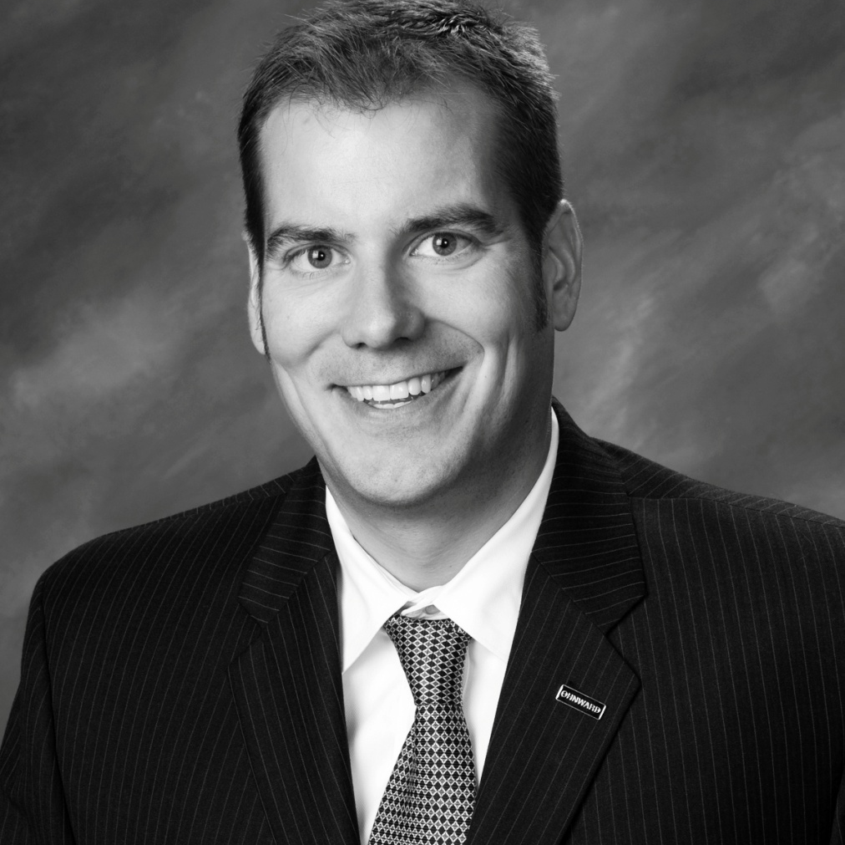
Inducted for Outstanding Contributions as a distinguished graduate of Central High School

Slide 3
Biography
Abe Tubbs is a 1989 graduate and record setting basketball player at Central. He was 2X First Team All-Conference at Cornell College and Player of the Year in 1993 & 1994. He helped them win a Midwest Conference title in 1993-94 and trip to the NCAA Division III tournament. He was a 3X All-Academic selection, Academic All-American and earned the NCAA Post Graduate Scholarship. He graduated Cum Laude in 1994 and earned his MBA in 1999. He is currently the Chairman of the Board & CEO for Ohnward Bank & Trust and President and CFO at First Trust State Bank in DeWitt. He is a member of the Cornell College Hall of Fame.

Slide 4
Article from the Observer
Associates say compassion and innovative thinking are two of the qualities that make Abe Tubbs stand out as one of Central Community High School’s distinguished graduates. Tubbs, a 1989 graduate, was a star student and basketball player at Central who went on to be one of Cornell College’s most highly-regarded players before becoming equally regarded in his chosen profession.
Tubbs excelled in academics at Central and Cornell, earning consistent dean’s list awards and maintaining a 3.7 grade point average in college while working toward a degree in economics and business. He received a master’s of business administration degree in 1999 from the University of Iowa.
He continues to exhibit the same dedication and leadership he showed as a member of Central’s and Cornell’s basketball programs in his position as president and CFO of First Central State Bank in DeWitt and chairman and CEO of Ohnward Bank and Trust in Cascade, Monticello, Marion and Cedar Rapids.
He is a past member of the Iowa Banking Association’s management committee, was named a rising star in banking by Northwestern Financial Review magazine and remains active in coaching multiple youth sports teams.

Slide 5
The Observer (cont.)
Tubbs has given back to the community where he now lives, Anamosa, by serving on a wide variety of economic development groups in Dubuque, Jones and Linn counties and as an active member of the United Methodist Church of Mt. Vernon. He also is a past board member of Genesis Medical Center-DeWitt, serving 2003-2006.
Tubbs was a standout basketball player under Sabers’ coach Neil Padgett 1987- 1989 and went on to achieve numerous honors during three seasons on the Cornell College basketball team 1992-1994. He was named Midwest Conference Player of the year in 1993 and 1994 and was selected for the First Team All Conference during the same seasons.
He also was selected for the Academic All-Conference Team 1992-1994 and served as team captain during his final year of play, where he averaged 22 points and 7.3 rebounds per game. He scored 1,240 points in his three seasons with the Rams, earning him the sixth spot in the 1,000-point club at that time.
The College Sports Information Directors of America selected Tubbs as an Academic All-American in 1993 and 1994, and in 1994, he was selected for the America All-District Team and was named Cornell College’s most outstanding senior athlete. He was one of just 14 men’s basketball athletes awarded an NCAA post-graduate scholarship and was inducted into

Slide 6
The Observer (cont.)
the Cornell College Athletics Hall of Fame in 2008.
Central High School principal George Pickup, at the time a history teacher and sophomore basketball coach, remembers Tubbs as an articulate young man and talented writer who gave his all in the classroom and the athletic arena. “He was just a class act on the court and off the court, too,”
Pickup said. Pickup sees Tubbs regularly in the community and said the former player still calls him “Coach” and enjoys talking about his family when they meet. He said he always expected big things from him based on his experience at Central. “I had a feeling he was going to be successful in the business world because he was a very ambitious, hard worker. He’s a quality person,” Pickup said.
Dave Updegraff, who has worked closely with Tubbs for 13 years as chief human resources officer at Ohnward Bancshares, said he has been impressed with the leadership Tubbs has shown by helping others advance their careers while doubling the size of the bank during his tenure.
“He’s extremely compassionate. He’s a very intelligent individual. He’s well educated, but he has an empathetic quality about him people can relate to,” Updegraff said.

Slide 7
The observer (cont.)
“He’s a good listener and has helped people grow their careers and solve problems and is able to handle the disciplinary side as well with compassion and preserve the employees’ dignity,” he said.
Updegraff said people gravitate toward Tubbs, and he has used those interpersonal skills to develop strong professional and personal relationships. His leadership style brings out co-workers strengths while minimizing their weaknesses, and his analytical mind leads him to make consistently solid business decisions.
“He has built a good leadership team and developed community relationships. That has allowed the organization to enjoy great growth in the last few years, even in these difficult economic times. He has an extremely analytical mind and understands what is required to make the business stable and profitable.
“The thing that impresses me the most is he’s innovative in his thinking. He’s concerned about making sure all the staff enjoy the work and grow their careers, and he’s adamant about maintaining a work-life balance ” Updegraff said.

Slide 8
Induction speech
Inducted for Outstanding Contributions as a Distinguished Graduate
The Tubbs name is synonymous with basketball in our community… half of that reason is 1989 graduate Abe Tubbs. Abe was an outstanding 3-year Varsity player for Hall of Fame Coach Neil Padgett. He still holds career records for Rebounds and Scoring at Central and was an All-Big Bend selection and a conference leader in Rebounds and Field Goal Percentage. Abe continued to shine during his 3-year career at Cornell College. He helped the Rams win the Midwest Conference Championship during the 1993-94 season, winning a program record number of games and a trip to the NCAA Division III Championships… the first ever for Cornell. He averaged 22 points and 7.3 rebounds per game and was a Team Captain. He was Cornell’s Most Outstanding Senior Athlete in 1994 and Conference Player of the Year in 1993 & 1994. Abe scored 1240 points during his 3 years in the Cornell lineup which ranks 7th for All-time Career Scoring. He also holds season and game records for Field Goal Percentage and Rebounds. He was a 2X First Team All-Conference selection, 3X Conference All-Academic selection and Academic All-American. He was a recipient of the NCAA Post Graduate Scholarship in 1994 and is a 2008 member of the Cornell College Hall of Fame. Abe graduated Cum Laude in Economics & Business from Cornell and earned his MBA from the University of Iowa with a 3.75 GPA in

Slide 9
Speech (cont.) & Video
1999. He graduated from The Stonier Graduate School of Banking-Georgetown University, Washington D.C., in 2004. At that time, he was recognized by Northwestern Financial Review Magazine as a “Rising Star in Banking. He has worked as an Assistant Basketball Coach at Coe College and was a Sales Representative from 1994-1998. He is currently the Chairman of the Board & CEO, Ohnward Bank & Trust, Cascade, Monticello, Marion & Cedar Rapids, a position he has held since 2006. Since 2001 he has served as the President & CFO at First Central State Bank in DeWitt.He has served on the Genesis DeWitt Hospital Board and the Iowa Banking Association Management Committee. He has worked with a wide variety of Economic Development groups in Dubuque, Jones and Linn counties and serves on various committees at the United Methodist Church in Mt. Vernon. He now helps coach youth sports teams. He and his wife Nicole, who is another Central Hall of Famer, live in Anamosa with children Ave, Ike and Zeke. Please help me welcome the newest member of the Central High School Hall of Fame, 2013 inductee… Abe Tubbs.

