Slide 1
Brent Jergersen
Central Dewitt Hall of Fame
Induction Class 2008

Slide 2
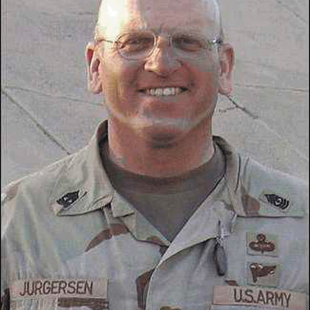
Inducted for Outstanding Contributions as a Distinguished graduate of Central High School

Slide 3
Biography
Brent Jurgersen is a 1980 graduate of Central High School. Brent excelled in Football and Track in high school. Brent also participated in Chorus (he was a 2x letter winner) and a member of the National Honor Society. In 1989, Brent Jurgersen joined the Army and still continues to serve our nation today. Brent has served in Iraq and was critically wounded in two different campaigns. He has earned numerous awards and commendations including 2 purple hearts and the bronze star.

Slide 4
Article from the Observer
SGM Brent R. Jurgersen may well have given new meaning to the term “distinguished graduate.”
Even prior to graduating from Central Community High School in 1980, Jurgersen, formerly of Low Moor and the son of Ronald and Lavonne Jurgersen, had accomplished a great deal.
He was inducted into the National Honor Society, participated in football as an offensive lineman and a defensive tackle/end, was a member of the “300 Pound Club” for weightlifting and was involved in track and chorus.
Jurgersen also was a two-time letter winner in football, track and chorus. He was a member of the 1978 Big Bend Conference co-champion football team, as well as the 1979 Big Bend Conference champion football team. His senior year, Jurgersen was awarded with the football “Horras Award” and the “Mind Wrapper Award for Outstanding Short Story.”
He also was selected for the Big Bend All-Conference Team as both a first-team offensive lineman and a first-team defensive lineman. Needless to say, following his successful high school sports career, Jurgersen was recruited by numerous colleges to play football.

Slide 5
The Observer (cont.)
Yet, eventually he chose to spend his life protecting the lives of others and serving his country, which Jurgersen has done proudly and honorably for the past 19 years.
After graduating from Clinton Community College with a degree in applied science in 1982, he married the former Karin Bradley of Camanche. For several years, the couple dairy farmed in Illinois and Wisconsin and had two children, Cassandra and Chase.
Then, in 1989, Jurgersen enlisted in the United States Army. Since that time, he has received numerous promotions to his current rank of Sergeant Major in April 2006. Also, while serving in Iraq, he was critically wounded twice while conducting combat operations.
In June 2004, while participating in a mission to reduce berms along a supply route, a bullet struck Jurgersen’s M16 and hit him in the face. The bullet shredded his upper lip and tissue under his nose, knocked out seven teeth and broke two others, shredded his tongue and lodged in his throat. Just four months later, he returned to Iraq where he sustained another injury in January 2005. Jurgersen’s vehicle was attacked and he was left with a skull fracture and brain hematoma, an injured right knee, a fracture of the right hand and ring finger, a deep wound to the left thigh and had to have his left leg amputated above the knee.

Slide 6
The Observer (cont.)
Although his injuries were extensive and he spent a month in the hospital, underwent several surgeries and major physical rehabilitation through July 2006, following his release from the hospital, Jurgersen returned to Germany to welcome his soldiers home from Iraq.
His numerous awards and decorations include the Bronze Star, two Purple Hearts, four Army Meritorious Service Medals, three Army Commendation Medals, four Army Achievement Medals, five Army Good Conduct Medals, two National Defense Service Medals, an Army and an Overseas Service Ribbon, an Iraqi Campaign Medal, a Global War on Terrorism Service Medal, a Valorous Unit Award and an Army Superior Unit Award.
Even with all of his awards, Jurgersen is extremely humbled to be inducted into his alma mater’s Hall of Fame.
“I thank the faculty of Central High School,” he notes in a letter which his brother, Kent, will read at the induction ceremony. “I thank the teachers, coaches, staff and principals. We were given knowledge; we were taught discipline, we were taught not to quit, but to finish whatever we started and we were taught about teamwork and pride. We learned about winning graciously and losing with dignity. They pushed us to help us realize our potential. They prepared us for life.”

