Slide 1
Brig Tubbs
Central Dewitt Hall of Fame
Induction Class 2013

Slide 2
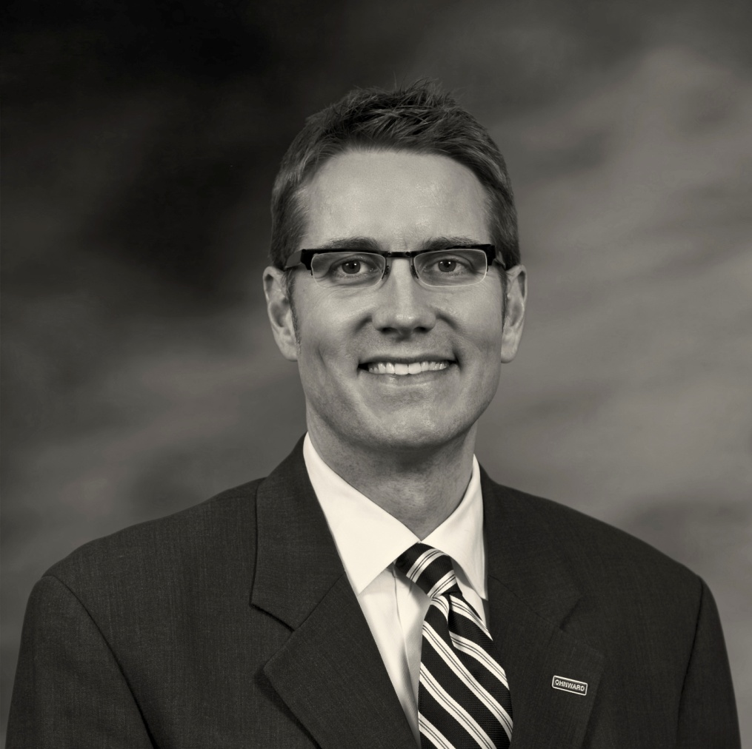
Inducted for Outstanding Contributions as a distinguished graduate of Central High School

Slide 3
Biography
Brig Tubbs was the 1987 Iowa High School Gatorade Basketball Player of the Year and First Team All-State selection for the Sabers. He was a starter for Dr. Tom Davis at the University of Iowa, playing from 1987-1992 on 4 teams to qualify for the NCAA Division I Basketball tournament. He was a 2X Academic All-Big Ten selection and served on the NCAA Student Athlete Advisory Committee. He was the recipient of the Nile Kinnick Memorial Scholarship while earning his MA. He is currently President and CEO at Gateway State Bank in Clinton and First Central State Bank in DeWitt. He is very active in many community organizations.

Slide 4
Article from the Observer
Those who know him say Brig Tubbs’ passion and dedication on the basketball court always has been reflected in his personal and professional life, and those qualities are part of what make him one of Central Community High School’s distinguished graduates.
Tubbs, a 1987 graduate, was a standout student and basketball player for Central and the University of Iowa before going on to a highly successful career in the banking industry. Throughout that time, he’s maintained close ties to the community through his involvement in numerous service-oriented organizations, giving back to the community that helped him achieve so much.
He is a member of the Clinton Rotary and former board member of the Mercy Hospital Foundation, Clinton Community Schools Foundation, Clinton County Visiting Nurses Association and Big Brothers/Big Sisters. He serves as a director on the Clinton Regional Development Corp. and the Clinton County Development Association.
All that, of course, is on top of his duties as president and CEO of First Central State Bank in DeWitt and Gateway State Bank in Clinton, where he has earned several professional honors in addition to serving on the board of the Iowa Banker Mortgage Corp.

Slide 5
The Observer (cont.)
At Central, Tubbs excelled in both academics and athletics, being named both to the National Honor Society and a first pick Des Moines Register’s 1987 All-State Team.
He was recruited by Tom Davis to play for the University of Iowa on a basketball scholarship, playing four years and earning several starts while helping the Hawkeyes reach the NCAA tournament all four years.
He continued to excel outside CarverHawkeye Arena, being named to the Academic All-Big Ten Team in 1990 and 1991 and receiving the Gregg H. Kucharo memorial award for athletic ability and academic excellence in 1990. He earned dean’s list recognition during this time and went on to work at the University of Iowa Foundation while attending graduate school on the Nile Kinnick memorial post-graduate scholarship, where he earned a master of arts degree in business in 1993.
Despite those accomplishments, lifelong friend Tim Sheridan said he’s still the same Brig Tubbs he first met in Mrs. Pacha’s third-grade class, where they became friends after competing with each other to complete division and multiplication tables during a math lesson. “Brig is a quiet, professional leader, very unassuming but very driven and very humble,” Sheridan said.

Slide 6
The Observer (cont.)
Sheridan describes him as a man of high integrity, who is full of passion for his family and life in general. The fact he was recruited from a small community to play for a Division I basketball team in the Big Ten speaks to Tubb’s character and desire to excel.
“He played as hard as he could and gave his heart and soul to the Iowa athletic program,” Sheridan said. Associate University of Iowa athletic director Mark Jennings, who hired Tubbs as a student intern in the athletic development office, said Tubbs caught his eye among the 600 or so student athletes eligible for the position.
“We selected Brig because he had a great personality to deal with donors and had an interest in furthering the cause of the University of Iowa. It was just a perfect fit,” Jennings said.
“Fundraising is a people business. It’s building relationships. Brig, even at that young age, had an outstanding personality, was pleasing to be around and easy to direct. We never worried about the job getting done. We knew it’d be taken care of in a good way,” he said.
Everyone who worked with Tubbs including former Iowa coach Tom Davis, expected him to go on to big things, Jennings added,

Slide 7
The observer (cont.)
“When I think of my years coaching at Iowa, I can’t help but think of the outstanding young men from the state of Iowa I was fortunate to coach and how much it meant to them to be Hawkeyes. Brig Tubbs represents the best of that group: well-educated, disciplined and caring young men that always were fun to be around. It made coaching at Iowa enjoyable every day,” Davis said.
“Brig Tubbs gave you the best he had at all times. Practice or games, classroom or travel, playing a lot of minutes or coming off the bench, Brig is someone you could depend on.
“There is no doubt in my mind he is the same as a family man and businessman. I am lucky and proud to have coached and been around him and his terrific family. It makes me smile to think of them, and I congratulate (Central) on honoring him. He is most deserving,” Davis said.

Slide 8
Induction speech
Inducted for Outstanding Contributions as a Distinguished Graduate
The second half of the Tubbs name being linked to basketball in our community is big brother Brig. Brig was a great Saber basketball player in the 1980’s while playing for Hall of Fame coach Neil Padgett. He was a high school scholar as a member of our National Honor Society. Brig Tubbs was a First Team All-State selection for the Sabers and 1987 Iowa High School Gatorade Basketball Player of the Year. He still holds program records for Rebounds & Scoring in a Career, Rebounds in a Game and Points and Field Goals in a Season. He attended the University of Iowa on scholarship and played for Dr. Tom Davis from 1987-1992. He was a member of 4 teams to qualify for the NCAA Division I Basketball tournament from 1988-1991 and started a number of games for the Hawkeyes. He was a 4X Letterman. He was recognized as a team and academic leader for Iowa. He received the 1990 Dodge NIT Student Athlete Award, the 1990 Greg Kuccharo Memorial Award for athletic ability and academic excellence, the 1991-92 Men’s Basketball Coaches Award and served on the NCAA Student Athlete Advisory Committee. Brig was the Men’s Basketball Academic Award winner in 1989-90 & 1991-92 and was a 2X Academic All-Big Ten selection. He earned his degree in Business and then pursued his Masters degree while earning the Nile Kinnick Memorial Scholarship and Ernest Zuber Post Graduate

Slide 9
Speech (cont.) & video
Scholarship. He worked for the University of Iowa Foundation while in graduate school and finished his degree in 1993. In 2002 he was recognized by Northwestern Financial Review Magazine as a “Rising Star in Banking. In 2005, he completed his degree from the Stonier Graduate School of Banking at Georgetown University, Washington D.C. As a professional Brig has worked as a Credit Analyst and Assistant Vice President of UMB Bank in Kansas City, MO and the Director of Iowa Bankers Mortgage Corporation before accepting a job with Ohnward Bancshares in Clinton, IA where he currently serves as CEO at Gateway State Bank. He is also the President and CEO of First Central State Bank in DeWitt. He has served as a Clinton Rotarian since 1998 and has been a Board Member on the Mercy Hospital Foundation, Clinton Community Schools Foundation, Clinton County VNA and Big Brothers/Big Sisters. He is a current Board Member of the Clinton Regional Development Corporation and Clinton County Development Association. He and his wife Kami have 3 children, Isabelle, Grace and Amelia. Please help me welcome the newest member of the Central High School Hall of Fame, 2013 inductee… Brig Tubbs.

