Slide 1
Casey kreiter
Central Dewitt Hall of Fame
Induction Class 2020

Slide 2
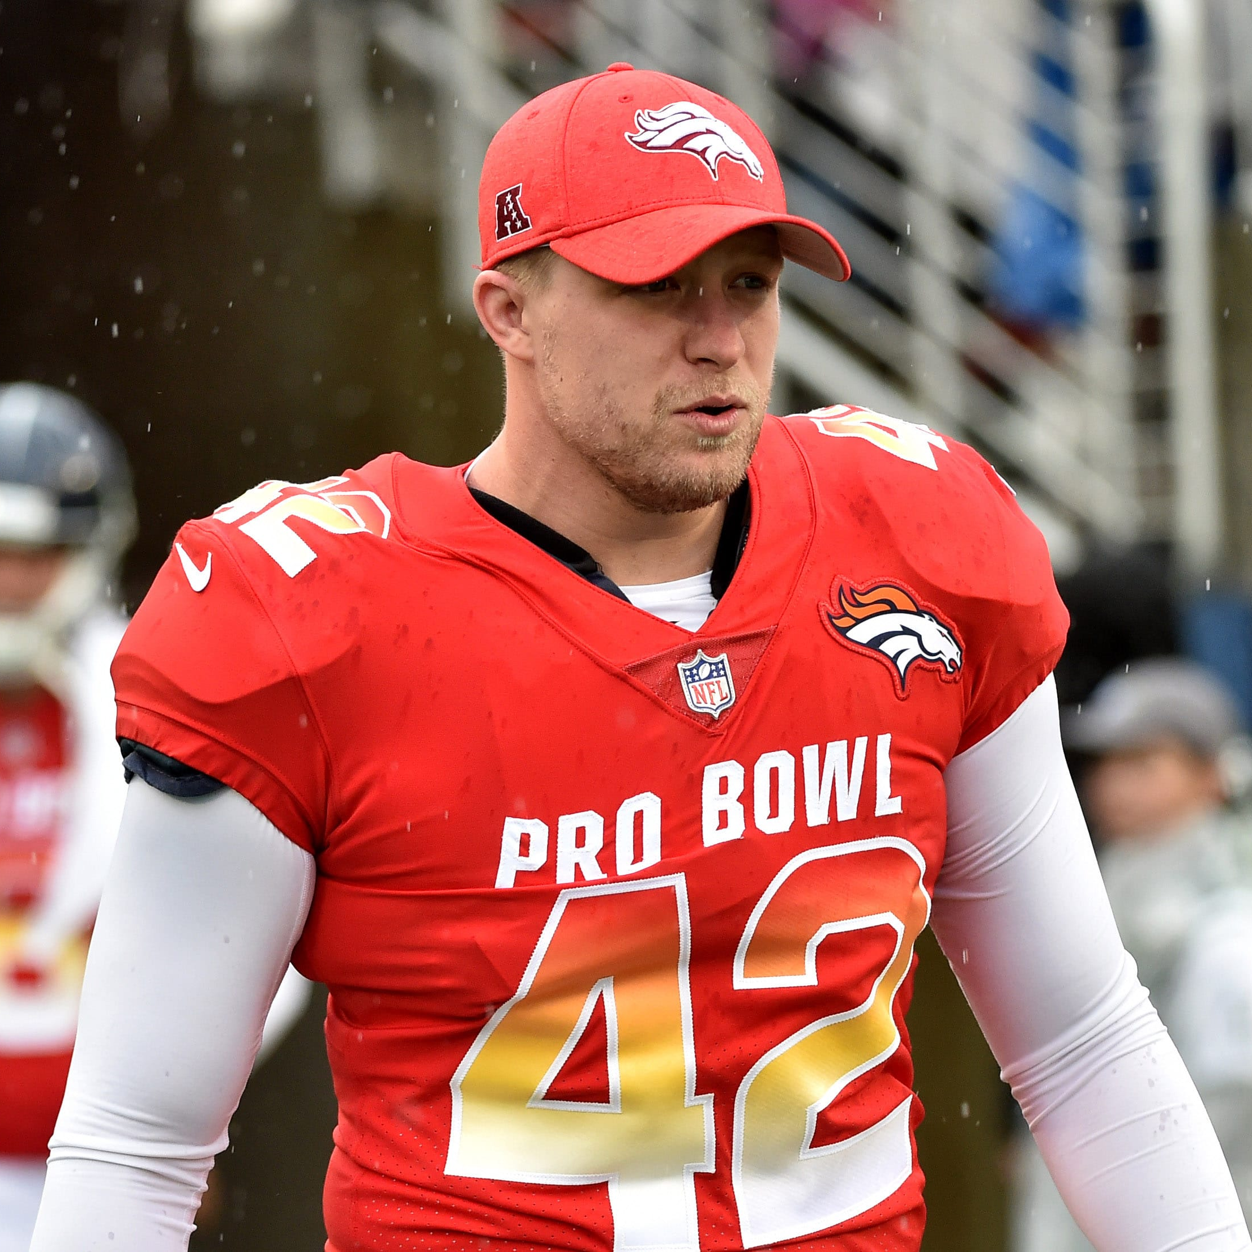
Inducted for Outstanding Contributions as an Individual of Central dewitt High School

Slide 3
Biography
Attitude and effort helped propel 2009 graduate Casey Kreiter into the NFL. He was a 2X, 110 High Hurdles Track State Qualifier, placed 6th at the 2009 State Wrestling tournament and was a 2007 2nd Team & 2008 1st Team All-State football player. He was a 3-year starting Long Snapper for the University of Iowa, playing in 4 Bowl games. He earned Honorable Mention All-Big Ten in 2013, was a 3X Academic All-Big Ten selection and was voted Team Captain. He signed with the Dallas Cowboys in 2014 & 2015 before making the 2016 permanent roster for the Denver Broncos. He earned a Pro Bowl selection in 2019. In 2020 he was recognized on both the Hawkeyes and Broncos All-Decade teams and is currently playing for the New York Giants.

Slide 4
Article from the Observer
As a freshman, Casey Kreiter’s only line in the school musical could accurately sum up his high school career: “Look, there it goes.” As a freshman in 2004, Casey Kreiter didn’t start on the football team. This year he begins his fifth season in the NFL with the New York Giants. Plenty of events took place in Kreiter’s life that helped him get from there to here. Many of those memories are formed around his years as a Saber athlete. Kreiter played football and baseball, wrestled and was on the Central DeWitt track & field team.
When reminiscing about his years wearing the purple and gold, Casey Kreiter’s mind goes to support from the Saber faithful. He remembers a particular playoff game in 2007 fondly. “I lived for Friday night under the lights,” he said. “I will never forget that frigid night in the playoffs against Keokuk … I could have sworn it was standing room only around Birney Field that night, and if you asked me I’d tell you everyone in DeWitt and Keokuk showed up for that game.”
The Sabers football teams Kreiter was a part of found piles of success. Kreiter himself was a two-time team captain, two-time letterman, two-time first team all-district player, and in 2008 was named a first-team all-state player. The Sabers in 2007 and 2008 won district titles and the 2007 team went undefeated in the regular season and finished as a state quarterfinalist. Kreiter, the son of Kurt and Jenny, turned his success on the gridiron into a decorated career at the University of Iowa. There, he became a three-year starting long snapper while earning a degree in science

Slide 5
The Observer (cont.)
education. As a Hawkeye, Kreiter earned multiple accolades for his performance on and off the field for the Hawkeyes, including the 2010 Team Leader Award, the 2013 Hayden Fry “Extra Heartbeat” Award, Brett Greenwood Award, Reggie Roby Special Teams Award and I-Club Team Leader Award. He was also awarded the Department of Intercollegiate Athletics Silver Medallion and was inducted into the National Football Foundation Hampshire Honor Society. Kreiter was a three-time member of the Hawkeye Leadership Group and represented the football team twice on the Iowa Student Athlete Advisory Committee. He played in the 2010 Orange Bowl, 2010 and 2011 Insight Bowl and the 2014 Outback Bowl. He was a 3-time Academic All-Big Ten recipient and earned Honorable Mention All-Big Ten honors in 2013 as a long snapper, while being voted as a permanent team captain.
Former Hawkeye placekicker and friend of Kreiter, Mike Meyer, said Kreiter watched hours of film and kept his teammates — and sometimes even his coaches — up to date on schemes on the field. “I’d sit in the office with him and we’d go through countless hours of film,” Meyer said. “Casey would break down the (film). He taught me how to look into different schemes for punt returns and kicks and how to lend a hand.”
Kreiter turned his college resume into a NFL career, and is beginning his sixth year as a long snapper in the NFL with the New York Giants. Kreiter played for the Dallas Cowboys in 2014 and 2015 after signing as a free agent. In the spring of 2016, Kreiter began teaching science in Iowa. That same

Slide 6
The Observer (cont.)
spring, while continuing NFL tryouts, he was signed by the Denver Broncos for what would be a four-year stint. As a Bronco, Kreiter served as a team captain and was the first Broncos long snapper named to the pro bowl. In 2020, Kreiter was recognized as a member of both the Broncos’ and Hawkeyes’ all-decade team.
On the baseball diamond, Kreiter played for the Sabers for four years, and was the starting third baseman on the 2007 district championship team. For the track & field team, he was a two-time team captain and state meet qualifier in the 110 high hurdles. He anchored the 2009 shuttle hurdle relay quartet that helped Central DeWitt win the 2009 state team track & field championship. On the wrestling mat, Kreiter was a WaMaC runner up at 189 pounds. He finished sixth at that weight at the 2009 state tournament. He was also a two-time member of the Iowa Cadet & Junior Iowa National Greco-Roman wrestling team.
While at Central DeWitt, Kreiter earned four academic letters, was the 2009 Bernie Saggau Award Winner and participated in musicals and the chamber singers. He helped the Special Olympics, the Science Bowl, student government and “all the other things that make Central DeWitt so great,” Kreiter said. Kreiter is married to his wife, Meghan. They have two children, Landen, 3, and Breckyn, 1.

Slide 7
Induction speech
Inducted for Outstanding Contributions as a Individual
Attitude & effort have been the hallmark of 2009 graduate Casey Kreiter. Those qualities combined with an unsurpassed work ethic have propel him into the NFL to become our school’s first professional athlete. He was an intense competitor & school leader. He earned 4 Academic Letters, 7 WaMaC Academic Awards in 4 sports and All-State Academic honors in football. He was the 2009 Bernie Saggau Award Winner and participated in Musicals & Chamber Singers. He was a 2X Baseball Letterman, playing 4 years, and a starting 3rd Baseman on the 2007 District Championship team. In track he was a 2X Letterman, 2X Captain and 2X State Qualifier in the 110 High Hurdles. He ran on the 8th Place Shuttle Hurdle Relay Team that helped the 2009 team win the 3A State Title. He was a passionate wrestler and was a Captain and 4X Letterman. He wrestled Heavyweight on the 2007 4th Place State Dual Team and was a 2X WaMaC Runner-up and 2009 2A 6th Place finisher at 189 pounds. Casey was also a 2X member of the Iowa Cadet & Junior Iowa National Greco Teams. As a football player, he transformed himself from a non-starting freshman to become a 2X Captain, 2X Letterman, 2X 1st Team All-District player, 2007 2nd-Team & 2008 1st Team All-State player. The 2007 & 2008 teams won District Titles with the 2007 team finishing as 3A Quarterfinalists & the 2008 team finishing 9-0 in the regular season. He became a 3-year starting Long Snapper for the University of Iowa while earning a degree in Science Education. As a Hawkeye he earned several team awards including the 2010 Team Leader

Slide 8
Speech (cont.) & video
Award, and in 2013 the Hayden Fry “Extra Heartbeat” Award, Brett Greenwood Award, Reggie Roby Special Teams Award and the I-Club Team Leader Award. He also earned the Department of Intercollegiate Athletics Silver Medallion and was inducted into the National Football Foundation Hampshire Honor Society. Casey was a 3X Member of the Hawkeye Leadership Group and represented the football team twice on the Iowa Student Athlete Advisory Committee. He played in the 2010 Orange Bowl, 2010 & 2011 Insight Bowl and the 2014 Outback Bowl. He was a 3X All-Big Ten Academic recipient and earned Honorable Mention All-Big Ten honors in 2013 as a long snapper while being voted as a permanent Iowa Team Captain. Casey was signed as a Free Agent in both 2014 & 2015 to the Dallas Cowboys and played in 3 pre-season games each season. In the spring of 2016, he signed a contract to teach science with the Iowa City School District. The same spring, while continuing NFL tryouts, he was signed by the Denver Broncos, made their roster and was perfect in attempts during 4 seasons. He was a Team Captain twice and in 2019 he became the first Bronco Long Snapper to be selected to the Pro Bowl. In 2020 he was recognized on both the Hawkeyes and Broncos All-Decade teams and the “Ultimate NFL 53-man Roster”. In 2020, he signed in Free Agency with the New York Giants. He is married to his wife Meghan, a Muscatine Muskie, and they have two children: Landen (3) and Breckyn (1)… our beautiful grandchildren! Please help me welcome the newest member of the Central DeWitt High School Hall of Fame, 2020 inductee… Casey Kreiter

