Slide 1
chuck knutsen
Central Dewitt Hall of Fame
Induction Class 2018

Slide 2
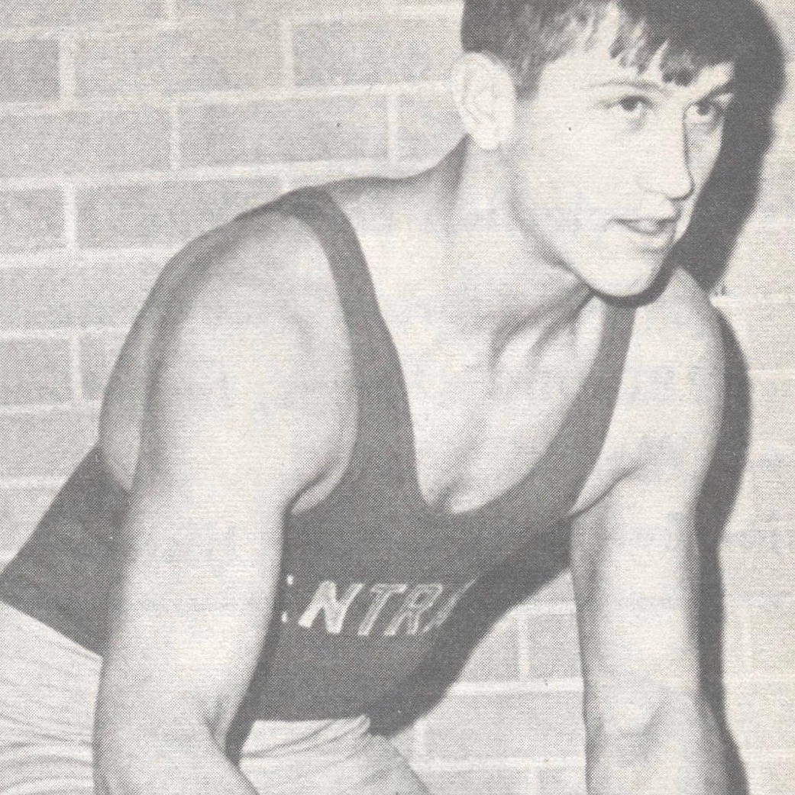
Inducted for Outstanding Contributions as an individual of Central dewitt High School

Slide 3
Biography
Chuck Knutsen is a 1968 graduate and was a 3-sport athlete and member/President of the Student Council. He was a 4-year participant in track and was an All-Illowa football selection. His career mark in wrestling was 71-12-1 and was an Illowa Conference Champion and 2X State Finalist. At the University of Dubuque, he was a 2nd Team All-Conference Linebacker and as a wrestler was a 3X Iowa Conference finalist winning the title in 1971. He is a member of the Spartan Hall of Fame. As a Newton HS teacher/coach he took the 1985 Boys XC team to State and lead the 1996 Boys Soccer team to 4th place at State. As the Wrestling Head Coach, he coached 20 State Qualifiers, 4 Runner-ups and 2 State Champions including over 100 Dual Wins.

Slide 4
Article from the Observer
When Chuck Knutsen reflects back on his high school graduating class, one thing comes to mind. “What I keep thinking is the class of ‘68 had so many great, competitive athletes. They made a lot of achievements in high school and beyond. I really enjoyed playing with them. It was an excellent experience,” he said in a phone interview from his Arizona home earlier this month.
While he spent several minutes extolling the virtues of his teammates, he didn’t talk much about his own accomplishments as a three-sport athlete who excelled on the football field and on the wrestling mat for the Sabers. Instead, he credited much of his athletic success to his brother Harold, who is seven years older. “He really started me off,” Knutsen said, adding that he followed in Harold’s footsteps to the University of Dubuque. While in high school, his brother participated in basketball, football and track; Knutsen found his home in football, wrestling and track.
Knutsen is being inducted into the Hall of Fame for his outstanding contributions as an individual. “It’s an honor,” he said. “I have a lot of great memories of DeWitt.” Kurt Kreiter, athletic director for Central DeWitt, pointed to many reasons why Knutsen is deserving of the recognition. “We have had wrestling in our school since 1930, and Chuck would be considered one of the all-time best to ever wear our singlet,” Kreiter said. He also noted that Knutsen was “a tremendous student leader,” serving as a

Slide 5
The Observer (cont.)
four-year member of the Student Council, including a stint as president his senior year. As Knutsen and his wife Monna still have family in the area, they get back to DeWitt several times a year, and this trip will be extra special. “We always enjoy it,” he said.
While at DeWitt, Knutsen participated in track, football and wrestling for four years, earning a 1968 All-Illowa Conference football selection at running back. He still holds an all-time program record by scoring five rushing touchdowns during a 1967 game versus Clinton St. Mary’s. Knutsen wrestled under legendary coach, Bob Hein, who passed away earlier this year. His sophomore year, Knutsen had a 19-5 record. The following year, he went 24-2, helping his team win the Illowa Conference championship and finishing as state runner-up. “As a senior, he became the only two-time finalist in our program history,” Kreiter said. Knutsen again finished as a state runner-up, only losing the single state final match. He ended the year with a record of 25-1 and outscored his opponents 121-14.
He left the DeWitt program with a 71-12-1 career record and still has one of the school’s best all-time winning percentages, Kreiter said, adding that Knutsen also was recognized as The Observer’s Athlete of the Year.
After high school, Knutsen went to the University of Dubuque, where he excelled in football, starting and lettering for four years. In 1971 he was selected to the Second Team All-Conference as a linebacker. In 1969 he was

Slide 6
The Observer (cont.)
the Iowa Conference wrestling runner-up and a member of an undefeated dual team. He was injured in 1970 but came back in 1971 to win the 167-pound Iowa Conference wrestling title. He became a three-time finalist in 1972, ending his season again as the conference runner-up. He graduated with a degree in physical education and psychology, and he has twice been inducted into the university’s Hall of Fame. Knutsen said he enjoyed coaching in sports that he played as a student athlete, as well as working with students in class.
“Teaching was a rewarding experience,” said Knutsen, who added that coaching was a natural extension for him. He started his teaching career at Lyons Middle School in Clinton. He continued at English Valley in North English, Iowa, where as coach he produced the school’s first state wrestling qualifier. In 1977, he went to Newton High School to begin a long career as a physical education teacher and coach. He retired in 2005. “I was in Newton for many years, and I had a good stint there,” he said.
His tenure at Newton was marked by taking the 1985 cross country team to the boy’s state tournament and starting the boys and girls soccer program in 1987. He led the boys to a fourth-place state tournament finish in 1996. As the wrestling head coach, his programs produced more than 20 state qualifiers, four runner-ups and two state champions. The 1993 Newton Cardinal team was district champion, and he coached more than 100 dual

Slide 7
The Observer (cont.)
wins. Knutsen earned his master’s degree from Truman State and Drake universities. Now retired, he and Monna have two daughters, Abbie Knutsen Friedman and Jessica Knutsen Eslick, and seven grandchildren.

Slide 8
Induction speech
Inducted for Outstanding Contributions as an Individual
Chuck Knutsen is a 1968 graduate and was a 3-sport athlete who excelled on the football field and on the wrestling mat for the Sabers. He was also a tremendous student leader during his time in school as a 4-year member of the Student Council, serving as President his senior year. Chuck was a 4-year participant in track, football and wrestling. In football he was a 1968 All-Illowa Conference football selection at RB. He still holds an All-time program record by scoring 5 Rushing TD’s during a 1967 game vs. Clinton St. Mary’s. We have had wrestling in our school since 1930 and Chuck would be considered one of the all-time best to ever wear our singlet. He was a Saber Invitational Champion & Illowa Conference Champion. Wrestling under legendary coach, Bob Hein, he had a very solid season his sophomore year with a 19-5 record. After that season, he took it to the next level. In 1967 he went 24-2 while helping his team win the Illowa conference championship. He finished as the State Runner-up. As a senior, he became the only 2X finalist in our program history. He again finished as a State Runner-up, only losing that single State final match. He ended the year with a record of 25-1 and outscored his opponents 121-14 that season. He left the program with a 71-12-1 career record, which is still one of the programs best All-time Winning %. He was awarded The DeWitt Observer’s Athlete of the Year. He enrolled at the University of Dubuque and continued to participate as a 2-sport athlete. Again, he was outstanding. He was a 4X Football Letterman and 4-year starter for the Spartans. In 1971 he was

Slide 9
Speech (cont.) & video
selected to the 2nd Team All-Conference as a Linebacker. He once again excelled in the sport of wrestling. In 1969 he was the Iowa Conference Wrestling Runner-up and a member of an undefeated Dual Team. He was injured in 1970 but came back in 1971 to capture that elusive championship by winning the 167 lb. Iowa Conference Wrestling title. He became a 3X finalist in 1972 ending his season again as the Conference Runner-up. He graduated with a degree in Physical Education & Psychology. He has twice been inducted into their Hall of Fame. He began his teaching career at Lyon’s Middle School in Clinton and the following year accepted a job at English Valley. As a coach he produced the school’s 1st State Wrestling Qualifier. Three years later he started a long career at Newton high school as a PE teacher and a coach. He took the 1985 Cross Country team to the Boy’s State tournament and in 1987 started the boys and girls soccer programs. He led the boys team to a State tournament 4th place finish in 1996. But once again his greatest success came through the sport of wrestling. As the Wrestling Head Coach his programs produced over 20 State Qualifiers, 4 Runner-ups and 2 State Champions. The 1993 Cardinal team were District Champions and he coached over 100 Dual Wins. He earned his Masters from Truman State and Drake Universities. Chuck is now retired with his wife Monna. They have 2 daughters, Abbie Knutsen Friedman and Jessica Knutsen Eslick and are proud grandparents of 7 grandchildren. Please help me welcome the newest member of the Central DeWitt High School Hall of Fame, 2018 inductee… Chuck Knutsen.

