Slide 1
Colonel Kay Smith
Central Dewitt Hall of Fame
Induction Class 2011

Slide 2
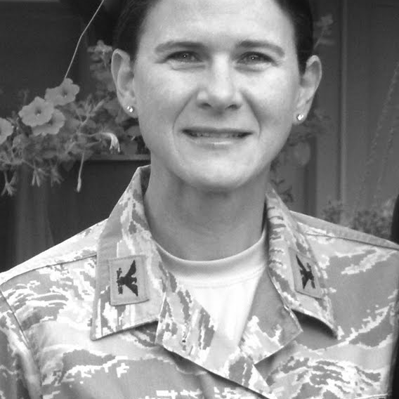
Inducted for Outstanding Contributions as a distinguished graduate of Central High School

Slide 3
Biography
Valedictorian and 1985 Central High School graduate, Kay Smith enrolled in the ROTC program at the University of St. Thomas as a means to pay for her education. Following being commissioned into the office corps after college graduation, she found a love for the US Air Force. Currently the First Weather Group Commander at the Offutt Air Force Base in Nebraska, Kay Smith has served in Panama, Germany, and the Middle East.

Slide 4
Article from the Observer
Kay Smith’s promotion to the rank of colonel made her the first DeWitt native to be so recognized by the U.S. Air Force. Only two other DeWitt natives have reached the prestigious rank — Capt. (retired) James Baird in the U.S. Marine Corps and another Central Hall of Fame inductee, Col. (retired) David Hilmers, U.S. Navy.
It all started as a way to pay for college following her graduation as a valedictorian of the Central Community High School graduating class of 1985.
Smith went on to complete ROTC on a four-year scholarship at the University of St. Thomas in St. Paul, Minn., where she majored in math.
After graduating with honors from college, where she lettered twice in track and cross-country, she was commissioned into the officer corps in 1989, agreeing to make a partial payback for her education in exchange for four years of service in the Air Force.
Although she says her sole intention was to pay back Uncle Sam and then do something else, she discovered she loved the military.

Slide 5
The Observer (cont.)
In the intervening years, Smith has served in numerous career fields and special duty assignments including weather, acquisition, executive officer, air operations officer, recruiting and officer accessions training (at both Officer Training School and the U.S. Air Force Academy). She served long tours of duty in Panama and Germany, and was deployed to the Middle East.
Twenty-two years, one undergraduate degree, three master’s degrees, 10 assignments, six promotions and several major decorations and awards later, Smith is the First Weather Group commander at Offutt Air Force Base in Nebraska.
That she has achieved the success she has is no surprise to anyone who knew her in high school, says her former teacher and coach Pam Duncan.
“I had the good fortune to have Kay in class in high school and also coached her in volleyball and track.
“She was a dedicated, hard worker, who overcame health issues to become a very valued athlete on the volleyball, basketball and track teams, winning two-year letters in each sport.

Slide 6
The Observer (cont.)
“She was a ‘quiet leader’ at that time, who led by example. She was a pleasure to work with,” Duncan remembers. When her former English teacher Dave Williams thinks of Smith, he associates the words, dedication, diligence, perseverance, ethics, honor, grace and class.
“In the academic as well as the athletic arena, Kay’s dedication to giving her best efforts (and the diligence with which she gave these) earned her deep respect from classmates and faculty. Yet, all the top marks, scholarships, athletic honors and the positive attention they receive did not spoil Kay. She was too well raised and much too firmly grounded to lose her way,” Williams says
And that may have helped save her life. Before Smith finished high school, cancer threatened to alter her course, but thanks to a number of individuals, Kay’s natural perseverance to reclaim her health would not be denied.
“The cancer never had a chance,” Williams says. “Kay endured to distinguish herself in college — and especially in the United States military, where under orders and under duress, soldiers inevitably react in accordance with their natural gifts,” Central HOF recognizes three alumni posthumously 2001 Central Cross-Country Team Williams continues.

Slide 7
The observer (cont.)
“It is those times in which ethics and honor most often come to fruition. Kay is — and always has been — a natural whose gifts have helped her handle many pleasant moments with grace and some not-so-pleasant times with class, all the way to the Hall of Fame.”
Former Observer sports editor Jeff Grant recalls, “It was about a quarter of a century ago our paths crossed for a short period. But I still am a regular reader of The Observer, and when I see Kay’s name in it from time to time, it always brings up pleasant thoughts from the past. “By the time I got to know Kay, she had overcome her bout with cancer; in fact, I don’t recall her ever even mentioning it. She was finishing up high school and had taken to living life to the fullest; one way she did that was through exercising abundantly.
“I worked as the sports editor/photographer at The Observer then, and when I wasn’t out covering a ball game or shooting pictures, I was running 5K and 10K races. Somewhere along the way, the editor’s young son, Matt Rueter, started joining me at the weekend competitions and then Kay also joined us, too. We were an odd trio: The 20-something guy, the teenage girl and the junior high-age boy,” Grant recalls.

Slide 8
The Observer (cont.)
“I don’t remember many details from the many races we did together every weekend throughout the warm weather months. What I do remember is we laughed a lot, and we had a lot of fun.
“Kay soon went off to college, and I eventually took a job on the other side of Iowa, but the fond memories of her and those days still float through my consciousness from time to time.”
It is moments like that that also stick in Smith’s mind. Her favorite high school memories center on playing sports. “Looking back, I realize all the life lessons learned — from how to win with style and lose with class to giving 100 percent every day.”
Lt. Col. Marc Van Wert, a close friend and colleague, considers Smith an amazing person. “She is dedicated, loyal, hardworking, honest and always positive,” he said in an earlier interview.
“Officers are chosen to the rank of colonel not because of what they have accomplished in the past, but what they are capable of doing in the future. The Air Force trusts (Smith’s) leadership abilities and her capability to perform at that next level . . . they call this strategic leadership. . . something she will do well at.”

Slide 9
Multimedia
MLB: Our Heroes
http://m.mlb.com/video/topic/54053166/v36914617/royals-salute-colonel-kay-smith

