Slide 1
Don McCune
Central Dewitt Hall of Fame
Induction Class 2007

Slide 2
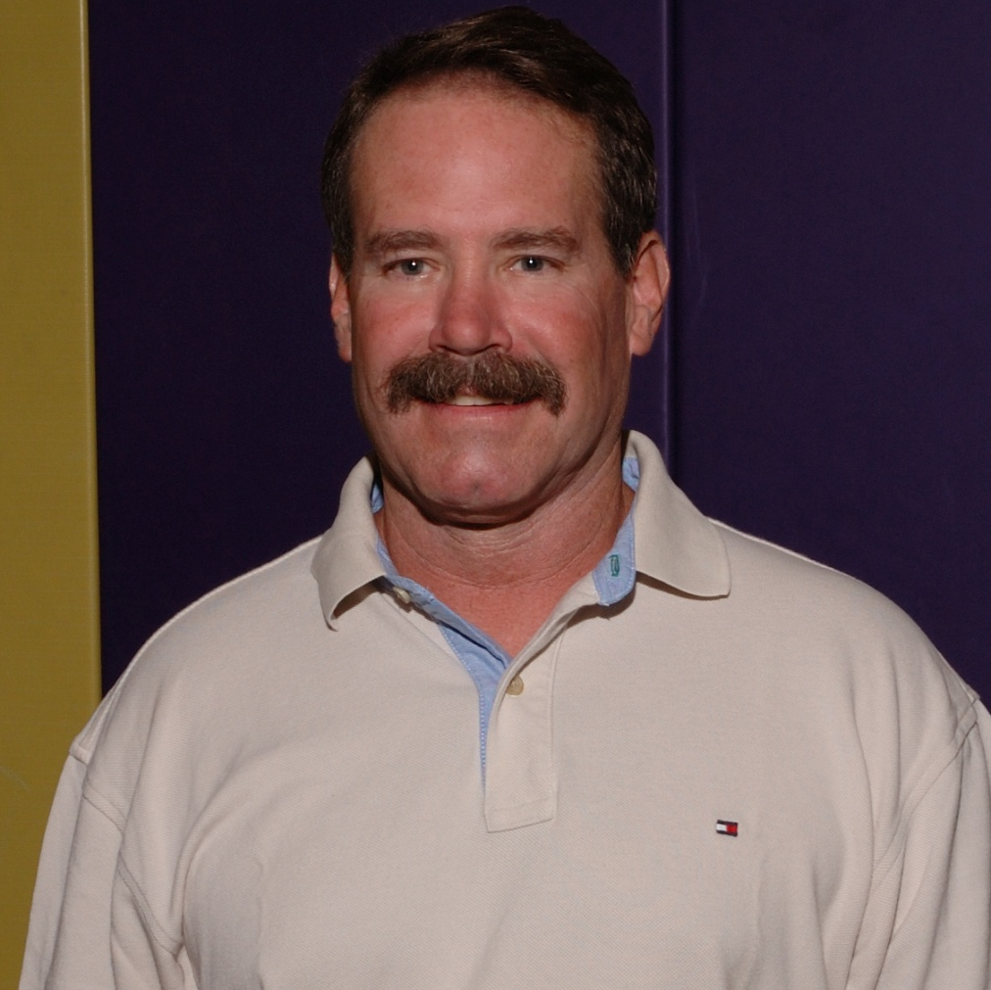
Inducted for Outstanding Contributions as an Individual of Central High School

Slide 3
Biography
Don McCune is a 1969 graduate of Central High School. Don McCune was an active high school student, participating in athletics as well as fine arts. As a Sophomore, Don McCune completed a perfect wrestling season by winning the State Championship at 95 lbs. Following graduation from Central, Don earned his bachelor’s degree from Wayne State University. After several years of teaching, Don ultimately decided to enlist in the Navy. That decision led to a 21-year career in that branch of the service.

Slide 4
Article from the Observer
In 1967 Don McCune made history in a couple of ways. By winning the 95-pound state championship, he became the first DeWitt or Central High School wrestler winning a state title. He also became Central’s first state champion in any sport.
McCune capped a perfect 16-0 sophomore season with a 4-0 win over Bondurant-Farrar’s Dave Hall in a firstround 95-pound match at the AA state meet. He advanced to the finals with a 2-0 win over Harlan’s Larry Kersten. Winning a second straight 2-0 decision, this one coming over Stewart Lang of Janesville gave McCune the state title.
McCune came extremely close to adding a second state championship to his resume. Following a 5-1 win over Mike McGonegle of Eagle Grove and an 8-2 win over Waukon’s Brian Murphy, McCune was wrestling for a state championship for the second time in three years.
Facing McCune in the 112-pound title match was Jim Taute of Humboldt. McCune looked to be on his way to another state championship, building a 4-0 lead. Taute, however, rallied, tying the match at 4-4 and sending it into overtime. When neither wrestler scored in the overtime session, it was left to officials to make a decision. Based on two pinning attempts in the overtime, Taute was declared the winner.

Slide 5
The Observer (cont.)
The loss ended an otherwise successful season for McCune. That year he set program records for points with 109, near falls with 28 and tied the program record for wins in a season with 25.
After graduating from Central, McCune received his Bachelor’s degree at Wayne State University. He taught in Australia for two-and-a-half years before moving to Glenrock, Wyo., where he taught and coached wrestling. McCune eventually made the decision to attend Naval Aviation Officer Candidate school. He spent 21 years in the Navy, before retiring as a navy commander 0-5.
McCune currently resides in Sheridan, Wyo. This past March, he retired from the Dept. of Veterans Affairs, as a manager for five outpatient medical clinics, all within the state of Wyoming. Since then, he has focused on renovating his residence and planning a move to Madison Valley, Mont., while in his spare time, he’s been traveling by RV throughout the continental United States and Mexico.

