Slide 1
Dr. dan roe
Central Dewitt Hall of Fame
Induction Class 2021

Slide 2
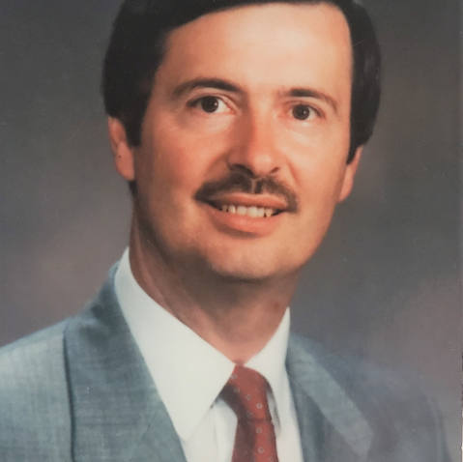
Inducted for Outstanding Contributions as an friend of Central dewitt High School

Slide 3
Biography
Dr. Dan A. Roe served as Central DeWitt’s Superintendent from 1996-2004 and developed a vision to establish a Hall of Fame that would “create a lasting tribute to those who have brought honor to themselves, their school, and our communities.” His vision became reality with our first induction class in 2003, designed to honor a wide range of contributions to our school through extraordinary feats in extra-curricular activities, those who have made great contributions to activities over a period of many years and graduates who have distinguished themselves in life after high school. Dan was a long-time member of the SAI and received numerous State and National School Administrator awards. He served in the United States Army from 1972-74.

Slide 4
Article from the Observer
The late Dr. Dan Roe is being inducted into the hall of fame that, at one time, was nothing more than a vision in his head.
As Central DeWitt’s superintendent from 1996-2004, Roe helped develop the Hall of Fame that would “create a lasting tribute to those who have brought honor to themselves, their school, and their community.”
Now, it’s his turn to be included. The hall first became a reality in 2003 and has since inducted a class each year. Since its inaugural class, Central DeWitt’s hall has become a blueprint from which other schools design their halls. “During my time as (Central DeWitt activities director), I had numerous school districts contact me regarding the use of our model to develop their own hall of fame,” said former Central DeWitt activities director Kurt Kreiter. “Dr. Roe’s vision has certainly made a positive impact on our school and for several communities beyond DeWitt.”
Before landing in DeWitt, Roe worked in many different locales over the course of his career in both the armed forces and education. The Iowa-born Roe was considered one of the top education executives in the country during his career and was known both as a superb educator and family man. He worked as the superintendent in DeWitt from 1996 until his retirement in 2004.

Slide 5
The Observer (cont.)
Roe was born in Fairfield, Iowa, and attended school in Mount Ayr, Iowa, throughout his childhood years — save for one year when his family lived in San Jose, California. A superb athlete, Roe won a state track & field title in the high hurdles in high school.
After graduating high school, Roe attended Northwest Missouri State University and obtained a bachelor’s degree in secondary education. He started working in Afton, Iowa, as a history and government teacher as well as a history coach.
However, shortly after taking the job, he was drafted into the U.S. Army. Roe served from 1972-1974 while stationed in Huntsville, Alabama, working on nuclear warheads. After being honorably discharged, Roe went back to Afton and taught for five years. At the same time, he went to school and obtained a master’s degree.
Roe and his wife, Marla, then moved to Union Star, Missouri, where Roe took his first education administrative position as superintendent. At the time he was the youngest superintendent in the state of Missouri. A few years later, he returned to Iowa as superintendent of the school district in Murray. While there he earned a doctorate degree from Drake University. He went on to hold multiple superintendent jobs in Bloomfield, Iowa, Lebanon, Missouri and Pittsburg, Kansas, before ending up in DeWitt for the remainder of his career.

Slide 6
The Observer (cont.)
In DeWitt, Roe set out on a mission to improve the DeWitt district. An article in The Observer by the sports editor at the time, Steve Thiltgen, said Roe had the goal of improving the facilities, educational environment and attitude.
Roe was a member of the School Administrators of Iowa and received numerous state and national school administrator awards. He was recognized as one of the top 100 executive educators in the U.S.
In addition to working at the school, Roe was an active member of the congregation at DeWitt United Methodist Church. He attended many DeWitt sporting events and enjoyed woodworking and golf.
He and Marla have one son, Michael. Roe died Dec. 14, 2020 while living at Westwing WellSpire Place in DeWitt.

Slide 7
Induction speech
Inducted for Outstanding Contributions as a Freind
Dr. Dan A. Roe served as Central DeWitt’s Superintendent from 1996 until his retirement in 2004. Steve Thiltgen, a longtime Sports Reporter at The Observer, once wrote that during that time he developed a list of items that he wanted to accomplish while here. Big or small, those initiatives were meant to improve our school District’s facilities, learning environment and attitudes. On that list, was the establishment of a Hall of Fame that would “create a lasting tribute to those who have brought honor to themselves, their school, and our communities.” Dan Alan Roe was born in Fairfield, Iowa and graduated high school from Mt. Ayr, Iowa. He was a 4-sport athlete, participating in baseball, football, basketball and track. He won the 1968 Iowa High School State Championship in the High Hurdles his senior year in a time of 14.9! After graduation he attended Northwest Missouri State University and continued to run Track. He received his B.S. in Secondary Education and landed his first job at East Union High School in Afton, Iowa, teaching History, Government and coaching Softball. He was drafted into the United States Army and served his country from 1972-1974, working on nuclear warheads. After his service, he returned to East Union and taught for five more years while earning his Master's degree. He then became Missouri’s youngest Superintendent while continuing his education, earning a Specialist degree from the University of Missouri and a Doctorate from Drake University. He held several other Superintendent positions before taking his last at Central DeWitt. Dan was a long-time member of the

Slide 8
Speech (cont.) & video
School Administrators of Iowa and received numerous State and National School Administrator awards, including an award as a top 100 Executive Educator in the nation. He enjoyed walking the school halls and talking with kids. In 2002, Dr. Roe put his vision of our Hall of Fame into action with the hire of Activities Director, Brent Cook, who had mentioned in his interview of experience implementing a Hall of Fame. Brent established a committee, that I was fortunate to be a part of, to develop the guidelines for our Hall of Fame. Designed to honor a wide range of contributions to our school through extraordinary feats in extra-curricular activities (Individuals & Teams), those who have made great contributions to activities over a period of many years (Coach-Sponsor & Friends); and graduates who have distinguished themselves in life after high school (Distinguished Graduates), we inducted our first class in 2003. During my time as AD, I had numerous school Districts contact me in regarding the use of our model to develop their own Hall of Fame. Dr. Roe’s vision has certainly made a positive impact on our school and for several communities beyond DeWitt. Dan attended the United Methodist Church and was a member of the DeWitt Noon Lions Club. He was passionate about Saber sports and loved woodworking, and an avid golfer. Dan was married to Marla Kay for 48 years and was so proud of his son Michael, both now and when he participated as a Saber. Michael and wife Danica have blessed Dr. Roe and Marla Kay with three grandsons, Kaidan, Keagan and Kolten. Please help me welcome posthumously, the newest member of the Central DeWitt High School Hall of Fame, 2021 inductee… Dr. Dan Roe.

