Slide 1
Dr. Wallace Ash
Central Dewitt Hall of Fame
Induction Class 2003

Slide 2
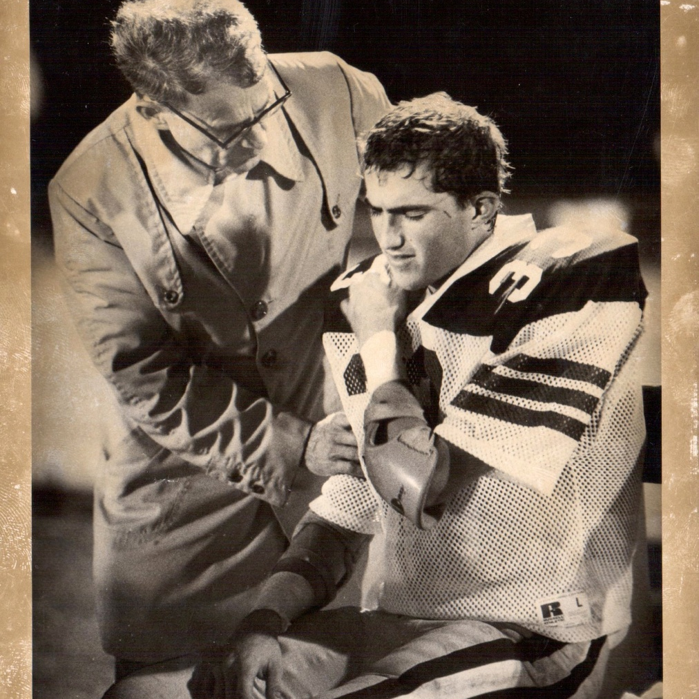
Inducted for Outstanding Contributions as a Friend of Central High School

Slide 3
Biography
Dr. Ash gave enormous support to the school as a long-time volunteer to the sports programs. For 33 years, Dr. Ash was a visible presence on the Central Sabers Football sidelines. Helping assess injuries and diagnose treatments for both Central and the visitors’ squads. As mentioned in The Observer, Dr. Ash even jokingly asked Coach Spangler if he should tell the opposing team’s injured player that he was not to return to the game. Anything to help give Central’s teams the edge. At one point during Dr. Ash’s tenure, he was honored by the Iowa High School Athletic Association as Team Physician of the year. Dr. Ash also gave his time to the school by serving as a Board Member for a number of years. Dr. Ash was also instrumental in the development of the Hart Center (now the DeWitt Fitness Center) and promoted health and fitness for both students and adults.

Slide 4
Article from the Observer
The category in which Dr. Wallace Ash is being inducted into the Central High School is as a friend of Central. He was much more than that — he was a friend to the entire community of DeWitt. For 33 years Dr. Ash patrolled the sidelines as the team doctor for the Saber football team. “He never missed a football game in town or out of town,” said his long-time nurse Marjel Mangan. Added Dwight Spangler, the Central football coach for many of those years, “He was a special guy.
I’m certainly proud and pleased he’s being inducted because he deserves it.” Spangler related an incident at one game that illustrates Dr. Ash’s sense of humor. When he worked the football sidelines, Dr. Ash not only took care of injured Sabers, he helped with the opposing teams as well if they requested his services. On one such occasion the other team’s star player went down. As Dr. Ash and Spangler walked out on the field, he looked to Spangler and with a smile on his face asked, “Do you want me to tell him he can’t play?” For his work with the Central football team Dr. Ash was honored as the Team Physician of the Year by the Iowa High School Athletic Association.
As much as he did for the football team, it was only a small part of his contributions to the community. He was someone who constantly gave of his time and services.

Slide 5
The Observer (cont.)
During his time in DeWitt, Dr. Ash served on the Central School Board, was president of the Clinton Medical Society, was a member of the United Methodist Administrative Board, was a member of the United Methodist choir and quartet, served as a counselor for the Junior and Senior Youth Fellowships, was a sponsor for Friday night open houses and dances at United Methodist, was a member of the DeWitt Park and Rec board for 33 years and was in the Clinton Symphony.
Of all the many contributions Dr. Ash made to DeWitt, the greatest and the one that will remain for a long, long time is the Hart Center. Long before the exercise and fitness boom hit, Dr. Ash knew the importance of taking care of your body. “He ran every single night and never put a thing in his mouth that wasn’t proper,” Mangan said. “Wally always come in wearing his jogging suit, which was always too short,” said Dr. Steven Hanas, who replaced Dr. Ash along the Saber sidelines and has his own medical practice in DeWitt, remembered. “He was really at the forefront of exercise. He was into nutrition and exercise before most people were.”

Slide 6
The Observer (cont.)
Because of his strong belief in keeping fit, Dr. Ash decided DeWitt needed a facility where people could jog, walk, swim, lift weights, play racquetball or work on exercise machines.
He also had medical offices included in the building. In addition to getting and keeping people fit, he hoped to measure and record how people progressed through exercising. “He spent a lot of time with the Hart Center,” Mangan related. “It was a dream of his. He didn’t build it for himself, he built it for the community. It was something he really wanted to do.” Dr. Ash saw his dream come true with the building of the Hart Center.
Eventually the city took over the day-to-day operations of the facility and now it is everything Dr. Ash envisioned when he began the project. Dr. Ash no longer lives in DeWitt. His wife Velma — “A lovely lady, very caring and very considerate,” said Mangan — moved to the community of Slater, located north of Des Moines about halfway to Ames. Hanas ran into him at a medical conference and reported Dr. Ash is very happy with his new surroundings and doing well. “He was always such a positive guy,” Spangler said. “He did so many things for the community. He was very community minded and he really cared about the kids.”

