Slide 1
Dwight Spangler
Central Dewitt Hall of Fame
Induction Class 2005

Slide 2
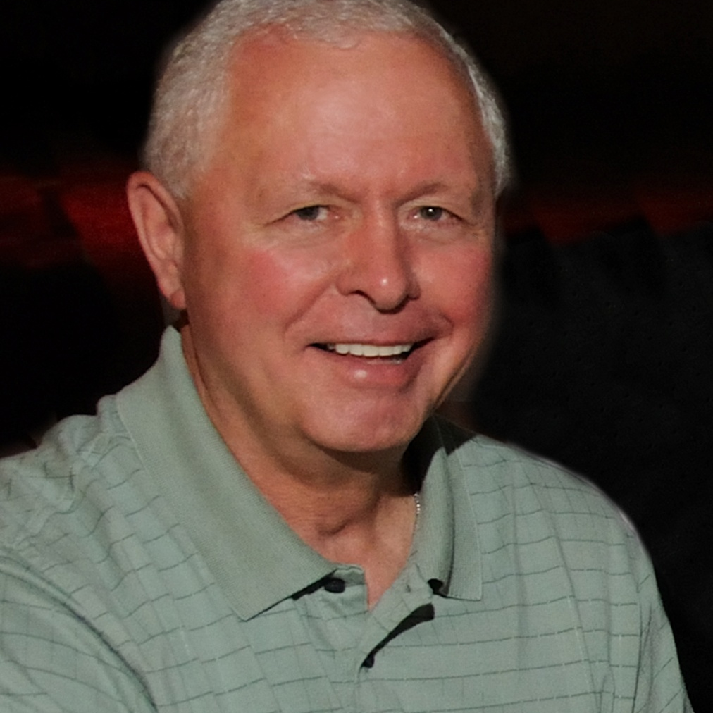
Inducted for Outstanding Contributions as a coach of Central High School

Slide 3
Biography
Dwight Spangler made a career of coaching, teaching, and directing Athletics at Central High School. Dwight came to the school district in 1971-72 and served as the World History teacher, Head Varsity Football, Assistant Wrestling, and Assistant Boys Track Coach. Throughout the years, Dwight Spangler taught a variety of classes to the students of Central High School. Although beginning as an Assistant Wrestling Coach, Dwight is well known throughout the State as an experienced and respected Wrestling official. Coach Spangler worked throughout the state and several State Wrestling tournaments in Des Moines. As Football Coach, Dwight was very successful, leading several teams to the IHSAA State Football playoffs. The 1973 team finished as the Class 3A State Runner-Up, while the 1987 qualified (but lost in the first round) and the 1999 team was a Quarterfinalist. Dwight Spangler is also a member of the Iowa Football Coaches Hall of Fame. Dwight Spangler also served the district for many years as the Athletic Director. During his tenure as A.D., both boys and girls athletic programs experienced great success. Especially in the girls programs, Dwight helped develop, with Pam Duncan, the girls athletic program from no offerings to what we offer today.

Slide 4
Article from the Observer
Throughout the long and storied athletic history of DeWitt/Central High School there have been a number of legendary figures responsible for the success of the athletic programs.
2005 Hall of Fame inductee Dwight Spangler belongs near the top of the list which also contains 2004 inductee Nat Baird, and 2003 inductees Harold Birney and Pam Duncan.
Many people associate Spangler with the football program. After all, he is a member of the Iowa High School Athletic Association’s Football Coaches’ Hall of Fame and he led the Sabers to a runner-up finish in 1974 and to the play-offs in 1987 and 1999. His influence on the school goes much deeper than football however. He was just as important to the entire athletic program in his role as the school’s athletic director.
One of those who appreciated all Spangler did was Duncan. The pioneer of girls’ athletics at the school, Duncan gives much of the credit for the rise of girls sports at Central to Spangler. “I think with so many people at other schools, the girls teams were treated as second rate. That was never the case with Spank. He looked at the athletic program as one team; not a boys team and a girls team.

Slide 5
The Observer (cont.)
Both were treated the same. At other places the girls were slighted, but not here,” Duncan said. “I felt we were so fortunate having him here. He was great working with. It was a big change at the time, but he was always very fair with us. I guess that’s what it boiled down to . . . he was always very fair. Any person who ever dealt with Spank will tell you he was very fair.”
Although he once joked that “when you you’ve been in one place as long as I’ve been here you’ve (ticked) off everybody off at least once,” few people have the respect Spangler still commands around the school, the community and the state.
A great example of that occurred just a few weeks ago following the Iowa football team’s win over Ball State. Following the game Spangler was socializing with one of his former players and current Hawkeye tailback, Marcus Schnoor and his parents, Dennis and Janelle. Soon the group was approached by Iowa Athletics Director Bob Bowlsby.
“Mr. Bowlsby told me how much respect he has for coach Spangler,” Marcus related. Like many of his former players and students, Spangler’s role in Schnoor’s life has evolved from when he was a student at Central.

Slide 6
The Observer (cont.)
“I’ve gotten to know him more as a friend than a coach or teacher,” Marcus said. “We still sit down and talk about football, but it’s on more of a personal basis now. He also talks to me about life in general and what I want to do in life. He has always been a class act.
I’ve never met anybody who has anything bad to say about him.” Meade has many connections with Spangler. He served on his football staff as an assistant, Spangler was his boss when he was the AD and Meade coached girls basketball and Meade replaced and preceded Spangler as the Central AD. The two also have a great friendship that has them getting together periodically.
“I guess I’ve spent a lot of time with him. I’m not sure if that makes me more tolerant, or what,” Meade joked. “I thoroughly enjoyed working with the guy from the moment I met him to his final days at Central. I like his perspective on things. He put the onus on the kids. I think that was the key to his success. Kids respond in a positive way when they have to be responsible for their success.” “He was a player’s coach,” Schnoor added. “You wanted to work hard for him. He always told us we were never going to get anywhere without working hard. He developed a work ethic in a person. He had a lot of trust in his players to let them do what they could do.

Slide 7
The Observer (cont.)
It was kind of neat in that aspect. He put the game in our hands, but he was always there on the sideline if we needed him.” Sit down and talk with Spangler for even a few minutes and you’ll soon be laughing. Whether it is with a joke, a funny story or a quick one-liner, he has a way of making people smile.
“Spank has a great sense of humor which is so important in life,” Duncan said. “He is quick-witted as all get out,” Meade added. “He has that special quality that in the sourest of times he can bring a smile to your face. I think his strength is he understands human nature. He never demanded respect or that people follow him, but he commanded respect and because of that, people followed. Everybody might not have agreed with him, but they always knew he was trying to do what was best for the kids.”
Spangler stepped down as Saber football coach following the 2000 season. He remained as the school’s AD through the 2001-02 school year. Although he is retired, he still teaches at Central as well as at other schools, as a substitute. Along with his wife Marilin, he now resides in Bettendorf. The couple has three daughters – Angie, Kelly and Kim – and five grandchildren, with a sixth (Kim’s first) on the way.

