Slide 1
Jim Hetrick
Central Dewitt Hall of Fame
Induction Class 2011

Slide 2
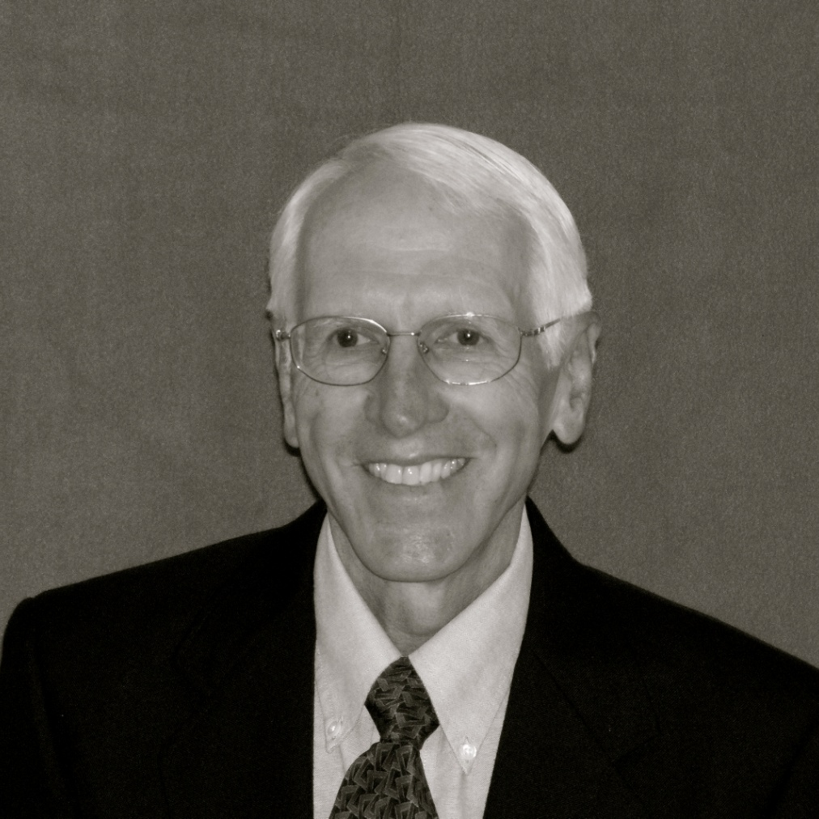
Inducted for Outstanding Contributions as a Sponsor and coach of Central High School

Slide 3
Biography
Jim Hetrick was an employee of Central Community Schools for 43 years until his retirement in 2010. Hired in 1967, Jim was initially a speech teacher and drama coach at the high school before becoming the district’s technology director. Jim also coached golf and cross country for the Sabers. Jim was a national finalist for High School Boys CC coach of the year in 2010.

Slide 4
Article from the Observer
Jim Hetrick has been a pillar in the Central Saber Athletic Department for many years. Even in his retirement, he continues to be a leader and promoter of cross-country and athletics in general.
Hetrick was a 1963 graduate of Fremont Ross High School, Fremont, Ohio. He graduated from Luther College in 1967; and in 1974, he obtained his master of fine arts degree from the University of Northern Iowa.
He began his teaching career at Central in 1967. In the early years, he taught speech, acting and stagecraft, debate and Media Now and directed the school’s plays and musicals.
“Jim was especially good at building sets and spent endless hours after rehearsals tearing down the structures only to rebuild them again before practice the next day as our ‘theater space’ was the Jim Hetrick Gloria Malooly Kay Smith stage at the end of the gymnasium,” says Carolyn Eggleston, who directed musicals with Hetrick for 10 or 11 years.
“Working with Jim on these projects was a very positive experience as he always worked to help the students perform to the best of their abilities in order to have a genuine feeling of accomplishment.”

Slide 5
The Observer (cont.)
The 1980s were a time of change in Hetrick’s career as he left directing for coaching and the classroom for technology. He developed the district’s cross-country program in 1980 as an extension of athletic programs for boys and girls who were not necessarily interested in the other traditional sports offerings.
Until retirement in 2010, Hetrick was the only cross-country coach Central ever knew. Through the years, he had a number of “unofficial” assistants who handled record keeping while the coach was either running or riding a bike to pace his runners or keep them “on task” out on the practice course.
Hetrick built the Central Sabers crosscountry team from just a few runners to the large team that continues today. “Between the middle school and high school teams, we take at least three buses to away cross-country meets,” Central athletic director Brent Cook says.
“Many schools arrive in vans or just one bus. At away meets, everyone knows Central is running, based on the caravan of buses the school takes. Hetrick built the program from a handful of runners to 60- plus at the high school level each year.

Slide 6
The Observer (cont.)
While coaching cross-country, Hetrick led two girls teams to state second-place finishes and two boys teams to first-place state finishes, not to mention countless other state appearances. “Jim Hetrick is a class act on and off the cross-country course,” former high school cross-country runner and current middle school coach Kerri Doom Olson says.
“I have had the rare privilege of running under his guidance as well as coaching alongside of him,” she says. “With these experiences, I have learned just how much of an impact a coach and/or teacher can have on their student athletes.
“Coach Hetrick has impacted me personally by helping make running and fitness a priority in my life, as well as inspiring me to carry on many of his philosophies of coaching with my own team,” she explains.
“I strive to emulate Coach Hetrick’s attitude and positive demeanor with my student athletes. Phrases like, ‘It’s a great day to run’ and ‘You can get through this,’ often are heard in my practices, echoing the same words that helped me survive my own workouts in high school,” Olson continues.
“He always taught me and made me feel all athletes have value and worth on the team.”

Slide 7
The observer (cont.)
Hetrick added coaching golf to his already busy schedule in 1981. In both cross-country and golf, he encouraged young athletes to expand their interests in ways that could continue as lifelong interests.
Hetrick’s coaching accomplishments earned him several honors as conference, regional and state coach of the year.
In 2010, Hetrick received a nomination by the National High School Athletic Coach’s Association for the national boys cross-country coach of the year.
As technology was introduced into the world of education, Hetrick became involved in introducing the computer age to the school district and eventually became the district’s first technology coordinator.
After 43 years, Hetrick retired from his technology and coaching positions with the Central Community District, but he remains an inspiration to young people, running with the team in retirement, encouraging them to set goals and enjoy running to reach them.

