Slide 1
JOE BECK
Central Dewitt Hall of Fame
Induction Class 2023

Slide 2
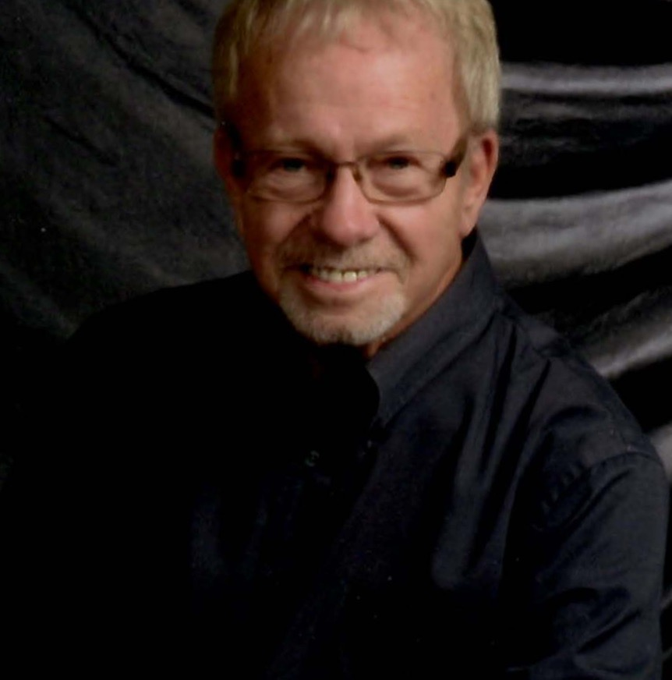
Inducted for Outstanding Contributions as a TEACHER of Central dewitt High School

Slide 3
Biography
No teacher’s name has come up more often than Joe Becks’ when asking inductees about positive influences that have helped them on the road to success. Mr. Beck earned his BS in Mathematics from North Dakota State University, a Master’s Degree from Kansas State and an advanced degree from the University of Iowa. He worked at Central Community in a distinguished career spanning 34 years from 1961-1995. During that time, he taught Algebra, Precalculus, Trigonometry, Physics and was on the ground floor for developing a new discipline, Computer Science! He served as the Head of our Math Department and was a Junior Class Sponsor. He was an Iowa Teacher of the Year in nominee in 1992. Few educators have achieved the level of respect that Mr. Beck has earned.

Slide 4
Article from the Observer
Joe Beck said that as strange as it may sound, he would compare his career as a high school mathematics teacher to being in a time warp. “What I saw never changed,” he said. “My students always were 16, 17 years old, year after year. It was always the same.”
Beck credits many of those students who sat in his classroom year after year for enabling him to make a career out of teaching a subject he loved, and for making him feel like it made a positive difference in their lives. In fact, one of his former students, astronaut and fellow hall of fame inductee Dave Hilmers, said, “On a personal note, I want to express my own thanks for the foundation that I received from you, Mr. Beck, in mathematics. In so many ways, that background has been instrumental in anything that I may have achieved. For that, I will forever be grateful.”
A signed photo of Hilmers that hung in Beck’s office reads, “To Joe Beck — Thank you for providing me with a good foundation in math. I hope that you have many more years of passing on your wisdom along to others. Best wishes, Dave Hilmers.” Beck earned his bachelor of science in mathematics from North Dakota State University, his master’s degree from Kansas State and an advanced degree from the University of Iowa. Beck was hired at Central DeWitt High School — or DeWitt High School as it was known at the time, home of the “DeHawks” — in 1961.

Slide 5
The Observer (cont.)
Until his retirement in 1995, he taught algebra, precalculus, trigonometry, physics and started the computer science program at the school. Beck also served as head of the math department and was the junior class sponsor. In 1992, he even was selected as an Iowa Teacher of the Year nominee. Following his retirement from Central DeWitt, Beck went on to teach for five years as an adjunct professor at Mount St. Clare College, in Clinton.
When he heard he was being inducted into Central DeWitt’s Hall of Fame for his outstanding contributions as a teacher, Beck said that the news came as quite a shock. He feels fortunate to have had a long, satisfying career he truly enjoyed and being honored for that was a completely unexpected, yet amazing, surprise.
“It was a good time,” Beck said. “It was a good job, and I enjoyed my students. I had some really good students, and worked with some really great teachers. Those teachers ended up being friends, which was really nice.” “I’m thankful to my students. Many of them were appreciative of what I did. I’ve had a few who came back and tell me so, which is nice. I really enjoyed my time at Central DeWitt.” Beck lives in DeWitt with his wife, Carol.

Slide 6
Induction speech
Inducted for Outstanding Contributions as a Teacher
Since the inception of our Hall of Fame in 2003, we have asked our inductees to share stories, favorite memories and significant influences that have helped put them on the path to success. We all know that teachers and staff have the potential to be one of those influencing figures. No teacher’s name has come up more often over decades of graduates than this year’s inductee Joe Beck. Often our teachers, coaches and staff have had a connection to students through activities or extra-curricular groups. Mr. Beck exerted his great influence in the purest of all school settings… the classroom! Joe Beck was raised and educated in Linton, North Dakota, graduating high school in 1952. He was interested in music, sports, horses and anything related to the outdoors. He attended North Dakota State University, earning a BS in Mathematics. He did graduate work at the University of Minnesota and Iowa State University, being awarded a National Science Foundation Grant. He finished his Master’s Degree in Mathematics from Kansas State University in 1967, also being awarded a National Science Foundation Grant. He would follow up that degree with an advanced degree in Mathematics from the University of Iowa in 1968. All of his coursework was aimed at helping him become a better teacher, and ultimately preparing students for math and science-based careers. He began his career teaching Math, Science, Band and Chorus at Isabel High School in South Dakota from 1957-1961. Faculty members who later worked with Joe would sometimes hear him share stories of those days at that school and how very different

Slide 7
Speech (cont.) & video
education and parental support was at the time. After a few years there, he and his wife Carol, also a teacher, were ready for a move and added their names to a North Dakota teacher recruitment list. Luckily for our community and generations of students, Dr. Ash, our School Board President secured a phone interview with Joe and as they say, “the rest is history”! Joe and Carol, now with sons Greg and Steve and a third son Scott on the way, made the journey to DeWitt. Joe went on to work the remainder of his career at Central Community, spanning 34 years and 4 decades from 1961-1995. During that time, he taught Algebra, Precalculus, Trigonometry, Physics and was on the ground floor for developing a new discipline that has now gone on to dominate our society… Computer Science! He served as the Head of our Math Department and was a Junior Class Sponsor. He was recognized as a Iowa Teacher of the Year in nominee in 1992. Joe was the consummate educator, professional and a tremendous mentor and role model for students AND for fellow new and established educators. Often, he could be heard in the teacher’s lounge, helping young teachers understand the importance of finance, investments and retirement planning. Few educators have achieved the level of respect that Mr. Beck has earned and his influences are now scattered in communities and professions throughout the country. After retirement, Joe continued to teach math at various community colleges and business schools. He loved teaching and worked outside the school day as an Adjunct Teacher for Mount St. Clare College, for the American Institute of Commerce for the Job Corp

Slide 8
Speech (cont.) & video
program and for Clinton Community College teaching GED classes in the evening. He has stays involved in his church. He remains active, enjoying snow skiing, sailing & other water sports and flying planes! He and Carol enjoy spending time with their children, their spouses and 5 grandchildren. Please help me welcome the newest member of the Central DeWitt High School Hall of Fame, 2023 inductee… Mr. Joe Beck.

