Slide 1
Joyce Fletcher
Central Dewitt Hall of Fame
Induction Class 2006

Slide 2
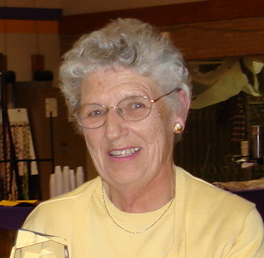
Inducted for Outstanding Contributions as a Friend of Central High School

Slide 3
Biography
Joyce Fletcher is a 1946 graduate of DeWitt High School. Joyce was extremely active in the choral and band programs during her high school career. Joyce was the student accompanist for the Mixed Chorus, Boys Glee Club, and Girls Glee Club. Joyce was a 4-year member of the band, playing the French horn and earning National honors. Joyce was a class officer in high school as well as an officer in the Student Council, as well as President of the Band during her senior year. Following graduation, Joyce attended Valparaiso University, majoring in piano. After returning to the DeWitt area, Joyce began a relationship with many, many groups, including Central High School as a talented accompanist. Joyce Fletcher has served as an accompanist for choirs, talent shows, children’s musicals, and bible schools. She has worked with students at Central High, Central Middle, St. Joseph’s, and Calamus-Wheatland schools.

Slide 4
Article from the Observer
A 1946 graduate of DeWitt High School, Joyce Fletcher developed a love affair with her high school that not only lasted the four years she spent walking the halls, but continues to this day.
While a student at DeWitt High School, it is hard to believe she had any time left over for school work. She served as accompanist for the school’s mixed chorus, the boys glee club, the girls glee club, was a member of the band for four years – including two years as president, she won national honors for her solo work on the French horn, was captain of the band as a senior, was a member of the pep band and the swing band. Once, during a high school production, the power went out. While waiting for the lights to be restored, Fletcher led the crowd in a sing-along in the dark.
In addition, she was a member of the Girls Athletic Association for four years, serving as its secretary for two years, was the secretary-treasurer of the student council for two years, as well as for her freshman and sophomore class, and served as secretary of her junior and senior classes. During high school, she won the Good Citizen award from the Addie Merrell Lee chapter of the Daughters of the American Revolution.

Slide 5
The Observer (cont.)
She also was the school’s 1945 homecoming queen. Following her graduation from DeWitt High School, Fletcher attended Valparaiso University where she majored in piano. After her college years, she returned to DeWitt, where for the last 60 years she has been organist, pianist and an accompanist for several men’s, children’s and mixed choirs. In addition, she has worked with talent shows, children’s musicals and vacation Bible school.
Fletcher also lent her considerable talents to many school productions, concerts, recitals and solo contests at both the Central High School and Middle Schools, St. Joes and Calamus-Wheatland, as well as serving as accompanist for the Village Voices for 20 years. She still is involved as a pianist/accompanist for local banks and dinners, weddings and funerals, as well as at Westwing Place and Amber Ridge.
Among the comments on her nomination to the hall of fame was this: “Joyce has the unique ability to play numerous pieces from memory or sight and can read, transpose and rearrange music for any person or group. One of the more sincere comments we have heard about her is ‘She can make anyone sing.’ The fact she is a true pianist, as well as an accompanist, makes her unique and outstanding. Few musicians have both qualities.”

