Slide 1
Kelsey steffens
Central Dewitt Hall of Fame
Induction Class 2016

Slide 2
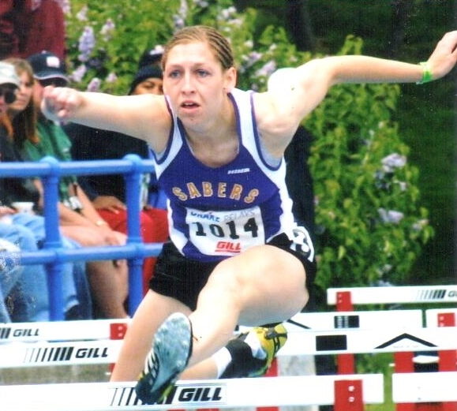
Inducted for Outstanding Contributions as an Individual of Central High School

Slide 3
Biography
2005 graduate Kelsey Steffens earned 13 Varsity Letters in 4-sports. She was All-tournament on the 5th place State softball team, All-State volleyball and All-Conference on the WaMaC champion basketball team. In track she earned 13 State medals, was a 3X State Champion and member of the 2002 State Champion team. She was the 2005 Drake Relays Outstanding HS Performer. At Wartburg she was a 2X All-District Academic selection in volleyball and in track was a 15X National Qualifier and 8X All-American. She was a member of 3 National Champion relay teams and Co-Captain of 2 National Champion teams. She was the Iowa Conference Female-Scholar Athlete of the Year and nominee for NCAA Women of the Year.

Slide 4
Article from the Observer
Any discussion about who was the best athlete in the history Central DeWitt High School must include Kelsey Steffens
No, not just the best female athlete. The best athlete, period.
To say she was an outstanding four-sport athlete in high school from 2002 until she graduated in 2005 just scratches the surface of who Kelsey Steffens is.
High school Principal George Pickup helped to coach girls track when Steffens was in school, including the hurdles. He recalls her outstanding athletic career, but said she was much more than a sports star.
“She’s a quality, quality person,” Pickup said, “as much as she was an athlete.” Steffens earned thirteen varsity letters in volleyball, basketball, track and field, and softball. She was a four-time recipient of the Academic Achievement award, graduating with a 3.86 GPA. And she earned four letters of participation in band.
But the most audacious number might be that in her four years as a varsity track star, she earned a maximum thirteen state medals, which, as far as anyone can tell, is a school record – for all athletes, not just for females.

Slide 5
The Observer (cont.)
Track was her best sport, but she was no slouch in the others. In three years of volleyball, she was second team all-conference as a junior, and first team as a senior, when she was also third team all-state.
During her two years of varsity basketball, she was honorable mention all-conference as a senior, when the Sabers girls won the conference title. In four years of softball, she was named all-conference three times during a stretch when the team won four conference titles. The Sabers finished fifth in the state in her senior year, when she also earned an all-tournament team honor.
In fact, among eight memorable high school athletic moments she recalled, seven in track – and one in softball. It was a running shoestring catch she made in left field her senior year. “I surprised myself,” she recalled with a laugh.
But in track, she was a superstar. Steffens was anchor of back-to-back state champion shuttle hurdle teams in 2004 and 2005. She was an individual state champion in the 100-meter hurdles in 2005. At the Drake

Slide 6
The Observer (cont.)
Relays, where she was a multiple qualifier, she anchored the 4x100-meter relay team that won the 2005 championship – against schools of all sizes.
In her senior year, she also medaled in three other Drake Relays events, which earned her the Drake Relays High School Girls Outstanding Performer. Then at the Senior All-Star meet, against competitors from neighboring states, she was named Outstanding Iowa Female Performer.
Steffens continued to excel in athletics at Wartburg College in Waverly, starring in volleyball and track and field (four varsity letters each, with numerous conference and All-American honors in Division III). Her senior year, she received the Elmer Hertel Award as the school’s outstanding two-sport female athlete.

Slide 7
Induction speech
Inducted for Outstanding Contributions as an Individual
2005 graduate Kelsey Steffens is likely the most decorated athlete to ever compete at Central. As a 4-sport athlete, she earned 13 Varsity Letters in volleyball, basketball, track and softball. She was equally accomplished in the classroom, earning 4 Academic Achievement awards and was elected the NHS as a junior. She was also a 4-year Letterwinner in band. She played softball on 4 Conference Championship teams including the 2005 team that won 45 games and finished 5th at State that year and was selected to the All-Tournament team. She earned 4 Letters and was a 3X All-Conference selection. Kelsey was also a 2X All-Conference and 3rd Team All-State volleyball player, earning 3 Letters in the sport. She earned 2 Letters in basketball, and was Honorable Mention All-Conference on a team that won the WaMaC title. Although outstanding in all sports, Kelsey excelled in Track. Earing 4 Varsity Letters, she medaled a school record 13 times at State and was a 3X State Champion as well as a member of the 2002 State Championship team. Two of her titles came in 2004 & 2005 on the Shuttle Hurdle relay team that owned the third fastest time in State history before the hurdles were raised 3 inches. Her individual State Championship came in the 100m hurdles in 2005. She was also the anchor of the 4x100m relay team that is Central's only female Drake Relays Championship. She was

Slide 8
Speech (cont.) & video
named the Outstanding High School Performer of the 2005 Drake Relays after medaling in 3 additional events. She was also named the Outstanding Performer at the Senior All-Star meet and at graduation held 3 Central DeWitt school records. She attended Wartburg College, graduating Magna Cum Laude in 2009 with an Elementary Education degree and was an Honor Cord recipient. She was additionally inducted into 4 academic societies. She was a Co-Captain of the volleyball team and earned 4 Letters as a 2X All-District Academic section. She finished her career 4th All-Time in Career Kills (1325). In track, she earned 4 Letters, was a 15X National Qualifier and 8X All-American. She anchored their National Championship 4 x100 meter relay team and also ran on 2, 4 x 400 National Champion relay teams. She was the Co-Captain of 2 National Championship teams. Upon graduation, she was part of 7 school records and Wartburg’s first ever Drake Relay title. In 2009, Kelsey was named the Female-Scholar Athlete of the Year by the Iowa Conference. That year she was also the Iowa Conferences nominee for NCAA Women of the Year. Kelsey is currently is an Instructional Coach at Garner-Hayfield-Ventura school district where she has taught math for 6 years. She has her MA from Drake University in Educational Leadership. She is also their Head Coach for volleyball and boys track. The track team has won 2 Conference Championships and she has earned Coach of the Year honors Please help me welcome the newest member of the Central DeWitt High School Hall of Fame, 2016 inductee… Kelsey Steffens.

