Slide 1
Nat Baird
Central Dewitt Hall of Fame
Induction Class 2004

Slide 2
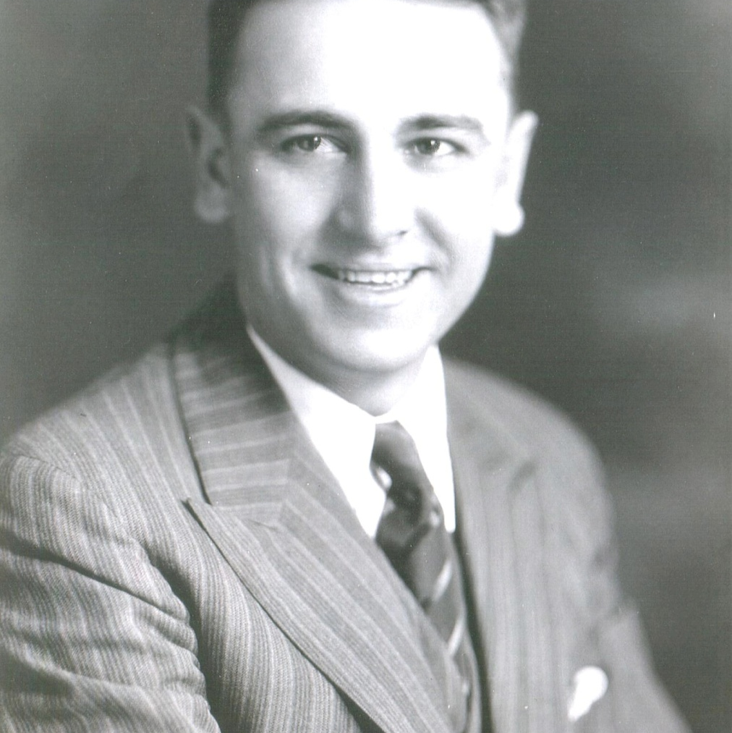
Inducted for Outstanding Contributions as an Coach of Central High School

Slide 3
Biography
Nat Baird could be inducted into the Central High School Hall of Fame in several categories; Individual, Coach, or Friend of Central High School. Mr. Baird competed in Football, Basketball, and Track while a student of DeWitt High School. Mr. Baird went on to Iowa State University participating in sports and many Golden Gloves boxing tournaments. Nat Baird returned to DeWitt in 1923 to teach and coach at DeWitt High School until 1943. During his time as coach, he had several teams perform well including the 1932 football team that went 7-0-1, which was believed to be un-scored upon. His teams were Clinton County Champions many times during the 1930’s. From 1943 until 1973, Mr. Baird worked for Iowa Mutual Insurance retiring as a Vice President. Nat Baird served on numerous boards, including DeWitt Community Schools, DeWitt Library Board, DeWitt Hospital Board of Directors, and a charter member of the DeWitt Noon Lions Club.

Slide 4
Article from the Observer
Very people have had as much of an impact on DeWitt as Nat Baird. Born and raised in DeWitt, Baird was an outstanding athlete at DeWitt High School during the late 1910s. An outstanding football player, he was listed as quarterback on the school’s all-time football team, which was chosen in 1933. After graduating from Iowa State, Baird returned to DeWitt as a head coach, history teacher and phys ed instructor at the high school. Baird served in that capacity from 1928 until 1943, when he left the school and took a position with Iowa Mutual.
At the time of his retirement, Baird had worked his way up to company vice president. If that was all Baird did, he would be a worthy candidate for the Central Hall of Fame. He did much more. Much, much more. Baird was a Boy Scout leader for 60 years, a 44-year trustee of the library board, a Sunday School teacher at the United Congregational Church of Christ for 40 years, was president of the school board and the hospital board and was an active member of the DeWitt Lion’s Club for 34 years and the DeWitt Masonic Lodge for 50 years. You wouldn’t think that left him much time to be a husband to his wife, Viola, and a father to his two children, son, Nat Jr., and daughter, Marian (Swanson). Not only was he an outstanding husband and father, he was a father-like figure to many DeWitt youths. “Nat was a native son who loved DeWitt. He was an incredible man

Slide 5
The Observer (cont.)
in many, many ways,” Bill Homrighausen, who was coached at DeWitt High School, and later hired at Iowa Mutual by Baird, recalled. “He was a role model for many young men in this town. He was concerned with their well being and their character. He was always interested in young people becoming good citizens. He was always in the right places, coaching, Boy Scouts, Sunday School, to do that. He was a good example for young people.”
Coaching in Baird’s era was much different than it is now. There were no coaching staffs; the staff was Baird. There was no offseason for him to work with his athletes. He coached football, basketball, golf and track. Being a one-man staff all year around didn’t seem to bother him much. His 1931 football team went 7-1-1. The 1932 team was 7- 0-1. The only score against Baird’s teams during that two-year stretch was an interception return for a touchdown. His 1936 team was the first Illowa champion. As basketball coach, he led the DeHawks to a 64-26 record. His teams won the Clinton County championship in 1929, 1932, 1934, 1936 and 1937; were the Blackhawk league champions in 1933 and 1934; and were sectional champions in 1934. His 1933 squad was the first DeWitt team winning a track meet. In 1931, he coached the first DeWitt golf team. In addition to his

Slide 6
The Observer (cont.)
coaching duties, Baird had to line up rides for his athletes. There were no school buses taking teams to and from events. Every Monday Baird called around lining up rides so all his players could get to the games.
Along with coaching football, basketball, track and golf, he organized a local boxing club and a Golden Gloves Boxing competition. At one time, there were 50 youngsters boxing at the Moose Club.
Coaching and teaching weren’t the only things he contributed to the school. He developed the DeHawk mascot and wrote the school fight song. He played a key role in getting the first football field and track built. A humble man, Baird would not allow the field to be named after him. A religious man, Baird never swore on the football field.
He preferred removing his hat, slamming it to the ground and stomping on it when frustrated. This, his son recalled, required him to purchase a new felt hat every year. “I don’t think anyone who ever played for Nat will ever forget him,” Homrighausen said. “When people came back into town, they always stopped in to see him because they admired him so much. “He is very, very deserving of this honor. You can’t even question that.”

