Slide 1
Ryan SWANSON
Central Dewitt Hall of Fame
Induction Class 2023

Slide 2
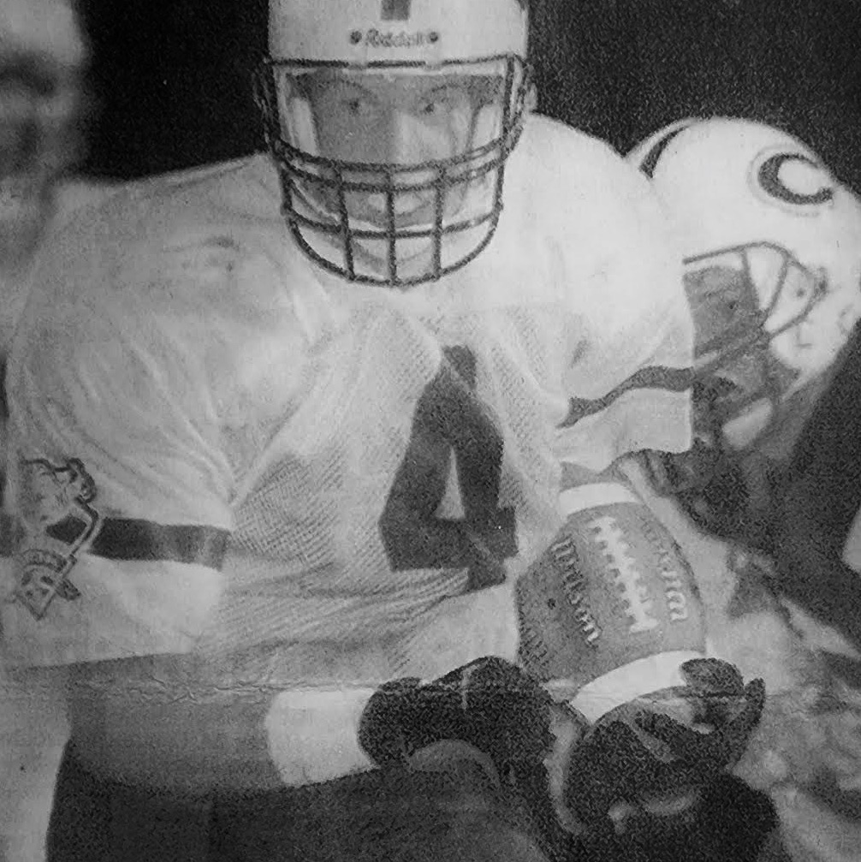
Inducted for Outstanding Contributions as an INDIVIDUAL of Central dewitt High School

Slide 3
Biography
Ryan Swanson was as imposing multi-sport athlete. He was a 2X Letterman and All-Conference Basketball player. In Track & Field he was a 2X Big Bend Shot Put Champion, 2X Shot Put State Qualifier and Discus Drake & State Placewinner. In football, he was a 2X Big Bend Player of the Year, 2X 1st Team All-District, 2X 1st Team All-Eastern Iowa and 2X All-State Player (3rd Team/Punter) & (1st Team Linebacker & Elite All-State Team). He holds top 3 program records for Longest Punt (80 yards - 6th as State Record), Solo Tackles in a Game (15), Assisted Tackles in a Season (103), Total Tackles in a Season (147), Tackles for Loss in a Season (17) Career Solo Tackles (88), Career Total Tackles (340) Career Assisted Tackles (162) He played in the 2000 Shrine Bowl.

Slide 4
Article from the Observer
From the time Ryan Swanson was 3 years old, all he ever wanted to do was suit up for the Sabers. In fact, once his high school sports career came to a close, Swanson confessed he couldn’t help but feel a little lost. However, now that he’s being inducted into his alma mater’s esteemed Hall of Fame for outstanding contributions as an individual of Central DeWitt High School, his talent never will be forgotten.
Described as an “imposing multi-sport athlete” for Central DeWitt, Swanson was a two-time letterman and all-conference basketball player. In track and field, he was a two-time Big Bend shot put champion, a two-time shot put state qualifier and Drake and state place winner in discus.
In football, he was a two-time Big Bend Player of the Year, two-time first-team all- district, two-time first-team All-Eastern Iowa and two-time all-state player (third team/punter), and first team linebacker and Elite All-State Team. Swanson holds program records for longest punt (80 yards, sixth as a state record), solo tackles in a game (15) assisted tackles in a season (103), total tackles in a season (147), tackles for loss in a season (17), career solo tackles (88), career total tackles (340), career assisted tackles (162), and he played in the 2000 Shrine Bowl.

Slide 5
The Observer (cont.)
“It’s all I ever wanted to do,” he said of playing sports for Central DeWitt. “Back when I played, I wanted to be the best to ever do it … I don’t think you can ever decide who was, but I was trying to be that.”
Needless to say, Swanson considers being inducted into Central DeWitt’s Hall of Fame a “huge honor” for him and his family. “Back when I was in school, the hall of fame wasn’t a thing,” he said. “So, I can’t say it was anything I ever imagined. I’m very happy for this honor, happy my children are going to be present and hopefully they will remember this honor.”
Of all the sports in which he excelled, Swanson said football always held a special place in his heart. He can recall knowing everything there was to know about the game — a skill, he joked, that did not exactly translate to his studies. “Football meant everything to me,” he said. “I could tell everyone on the team exactly what each person’s responsibilities were for every play, no matter the position. I knew the play book inside and out … unfortunately, I did not know my school books to the same capacity.”
Swanson said he would like to thank his parents, who invested time and money traveling to his games and were his “biggest supporters.” He also is grateful to have played for exemplary coaches, including his football coach,

Slide 6
The Observer (cont.)
Dwight Spangler. “Coach Spangler has always been like a grandfather/father figure to me, as well as a very important and respected coach. I feel he is the epitome of what a head coach is … if you look up head coach in the dictionary, a picture of Coach Spangler should be with the definition.”
Swanson currently owns and manages properties, farms and owns a bank pole fishing business, Cat Daddy, LLC., and works at Twin State Engineering, in Durant. He and his wife, Allison, have two children: Raylee, 10; and Calvin, 7.

Slide 7
Induction speech
Inducted for Outstanding Contributions as an Individual
Ryan Swanson was an imposing high school multisport athlete and could certainly back it up during competition. He was outstanding in all of his sports, participating in football, basketball and track. He was a 2X Letterman in basketball and as a Junior was named Honorable Mention All-Conference on a team that finished 15-5 and won a Big Bend Championship playing for Hall of Fame Coach Neil Padgett. He earned 2nd Team All-Conference honors as a Senior. In Track & Field he didn’t wait so long to make an impact. Improving his Shot-Put distance an incredible 11’ from the start of his season, his throw of 49’7 would elevate him as Big Bend Shot Champion as a Freshman. He would repeat as a Big Bend Champion as a Sophomore on a team that won 8 of their 10 meets including a Big Bend Championship. That season he would also Qualify for State in the Discus. He was selected as Team Captain as a Junior and in his Senior year Qualified for Drake in the Discus, placing 10th and Qualified for State in both Shot & Discus, placing 13th in the Shot and 3rd in the Discus. As a football player, he was a dominating force…on every unit… offense, defense and special teams. He was moved up to the Varsity level as a Sophomore and was a punting sensation. But even as a young player in the middle of the defense, he led the team in Tackles. The team ended with a 1-8 record. The following year, they turned things around going 7-2, just missing the Playoffs. He was named the Defensive Captain for The Observer’s All-Area team and was a unanimous pick as the

Slide 8
Speech (cont.) & video
Big Bend Player of the Year. He earned 1st Team All-District, 1st Team All-Eastern Iowa and 3rd Team INA All-State recognition as a Punter. As a Senior, he led the 1999 “Purple Reign” team to the 3A State Quarterfinals and an 8-3 record under Hall of Fame Head Coach Dwight Spangler. He was recognized as a Pre-season All-State selection. He again was The Observer’s All-Area Captain and unanimous pick as Big Bend Player of the Year. He was recognized as 1st All-District Linebacker and 1st Team Punter. He was the Clinton Herald Defensive Player of the Year and an All-Eastern Iowa 1st Team Defensive player. He earned 1st Team INA All-State and Des Moines Register’s 1st Team Linebacker and Elite All-State Team honors. He finished his career as a 3-year starter and 3X Letterman and still holds program records for the Longest Punt of 80 yards, which is currently 6th best All-Time as a State Record. He is also 1st All-Time for Solo Tackles in a Game (15), 5th All-Time for Solo Tackles in a Season (44), 2nd All-Time for Assisted Tackles in a Season (103), 2nd All-time for Total Tackles in a Season (147), 1st All-Time for Tackles for Loss in a Season (17), 3rd for Solo Tackles in a Career (88), 1st for Assisted Tackles in a Career (162), 4th Tackles for Loss in a Career (19) and 1st for Total Tackles (340). He was invited to play in the 2000 Shrine Bowl. He went on to play college football for Iowa Central Community College & Waldorf College. In high school, Ryan Qualified for an International Bowhunting Organization World competition and as an adult, has stayed active in the outdoors. Currently he owns & manages properties, farms, owns a bank pole fishing business, Cat Daddy llc and works at Twin State Engineering in Durant. He

Slide 9
Speech (cont.) & video
volunteers yearly at the County Fair and for the Adopt a Highway program. He and his wife Allison have 2 children, Raylee (10) and Calvin (7). Please help me welcome the newest member of the Central DeWitt High School Hall of Fame, 2023 inductee… Ryan Swanson.

